Slide 1
Elite/U23/Jr/Para Aquathlon Briefing
Wednesday, September 14

Slide 2
Agenda
Welcome and Introductions
Competition Jury
Schedules and Timetables
Check-in and Procedures
The course
Post-Race Procedures
Weather forecast

Slide 3
Welcome and Introductions
TD Ulf Schuetze (CAN)
Assistant TDs Enrique Quesada (ESP)
Ivette Bourette (PAN)
Scott Weinheimer (USA)
Race Referees Leslie Buchanan (CAN)
-Elite, U23, Junior Men, Relay
Felix Molina (MEX)
- Elite, U23, Junior Women, Aquathlon, AG
Medical delegate Humberto Aguilar (MEX)
Local Organizing Jorge Reyes and Mau Zavala (MEX)
Committee (Race Director)

Slide 4
Competition jury – Elite/U23/Jr/Para Aquathlon
Scott Weinheimer (USA), a-TD (Chair)
Terry Sheldrake (NZL), ITU EB
Jaime Cadaval (MEX), Host NF

Slide 5
Schedule and Timelines
Tuesday, September 13 (Today)
11:00 - 12:00 Elite/U23/Jr/Para Aquathlon Briefing Cozumel & Resort Hotel
16:00 - 17:00 Aquathlon Swim Familiarization Fonatur Triathlon Park

Slide 6
Schedule and Timelines
Wednesday, September 14 (Tomorrow)
7:00 - 7:45 Elite/U23/Jr/Para Aquathlon Fonatur Triathlon Park
Transition Check In
8:00 Elite/U23/Jr Men Aquathlon Fonatur Triathlon Park
World Championships
8:05 Elite/U23/Jr Female Aquathlon Fonatur Triathlon Park
World Championships
8:20 Para PT5 Female Aquathlon Fonatur Triathlon Park
World Championships
8:45 Elite/U23/Jr Aquathlon Fonatur Triathlon Park
World Championship Awards Ceremony
18:00 - 19:00 Opening Ceremony Benito Juarez Main Square
20:00 – 22:00 Pasta Party & Para Aquathlon Playa Mia Beach Club
Awards Ceremony

Slide 7
Elite/U23/Jr/Para Aquathlon Transition Check In

Slide 8
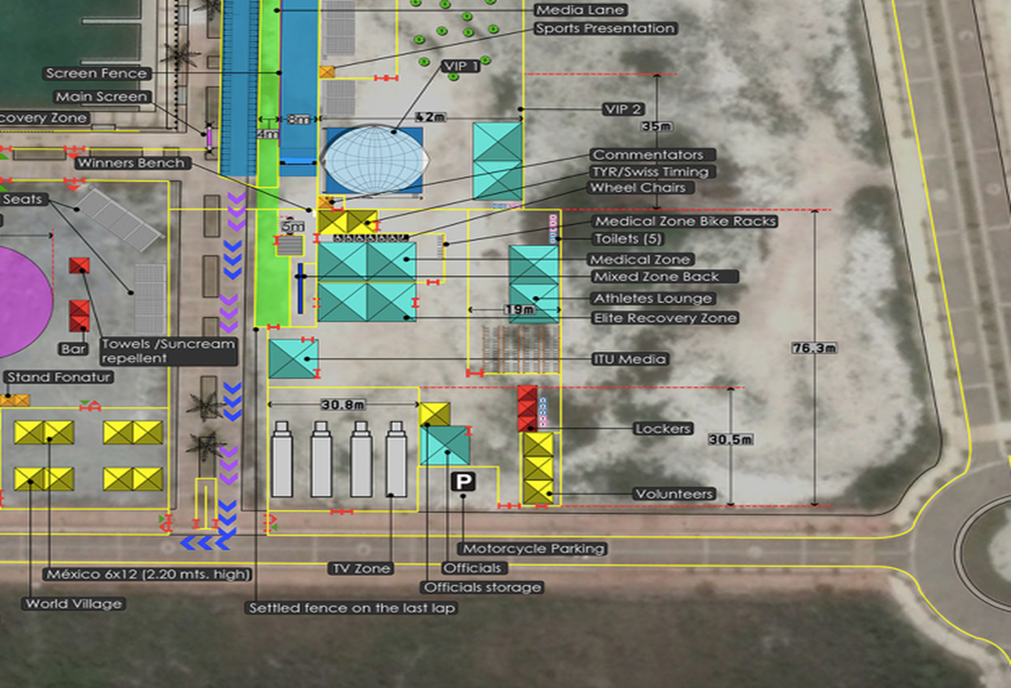
Elite/U23/Jr/Para Aquathlon Transition Check In

Slide 9
Aquathlon AG Transition
Check In
You will need to park after the Park Royal Shopping Center and walk or take the free shuttle into the venue.
Transition Area
Uniform check (name, country, logos, ITU logo, zippers)
Timing chip check (1 for the ankle)
Swim cap check

Slide 10
The Course
Run
1 lap of 2.5 km
Swim
1 lap of 1.0 km
Run
1 lap of 2.5 km

Slide 11
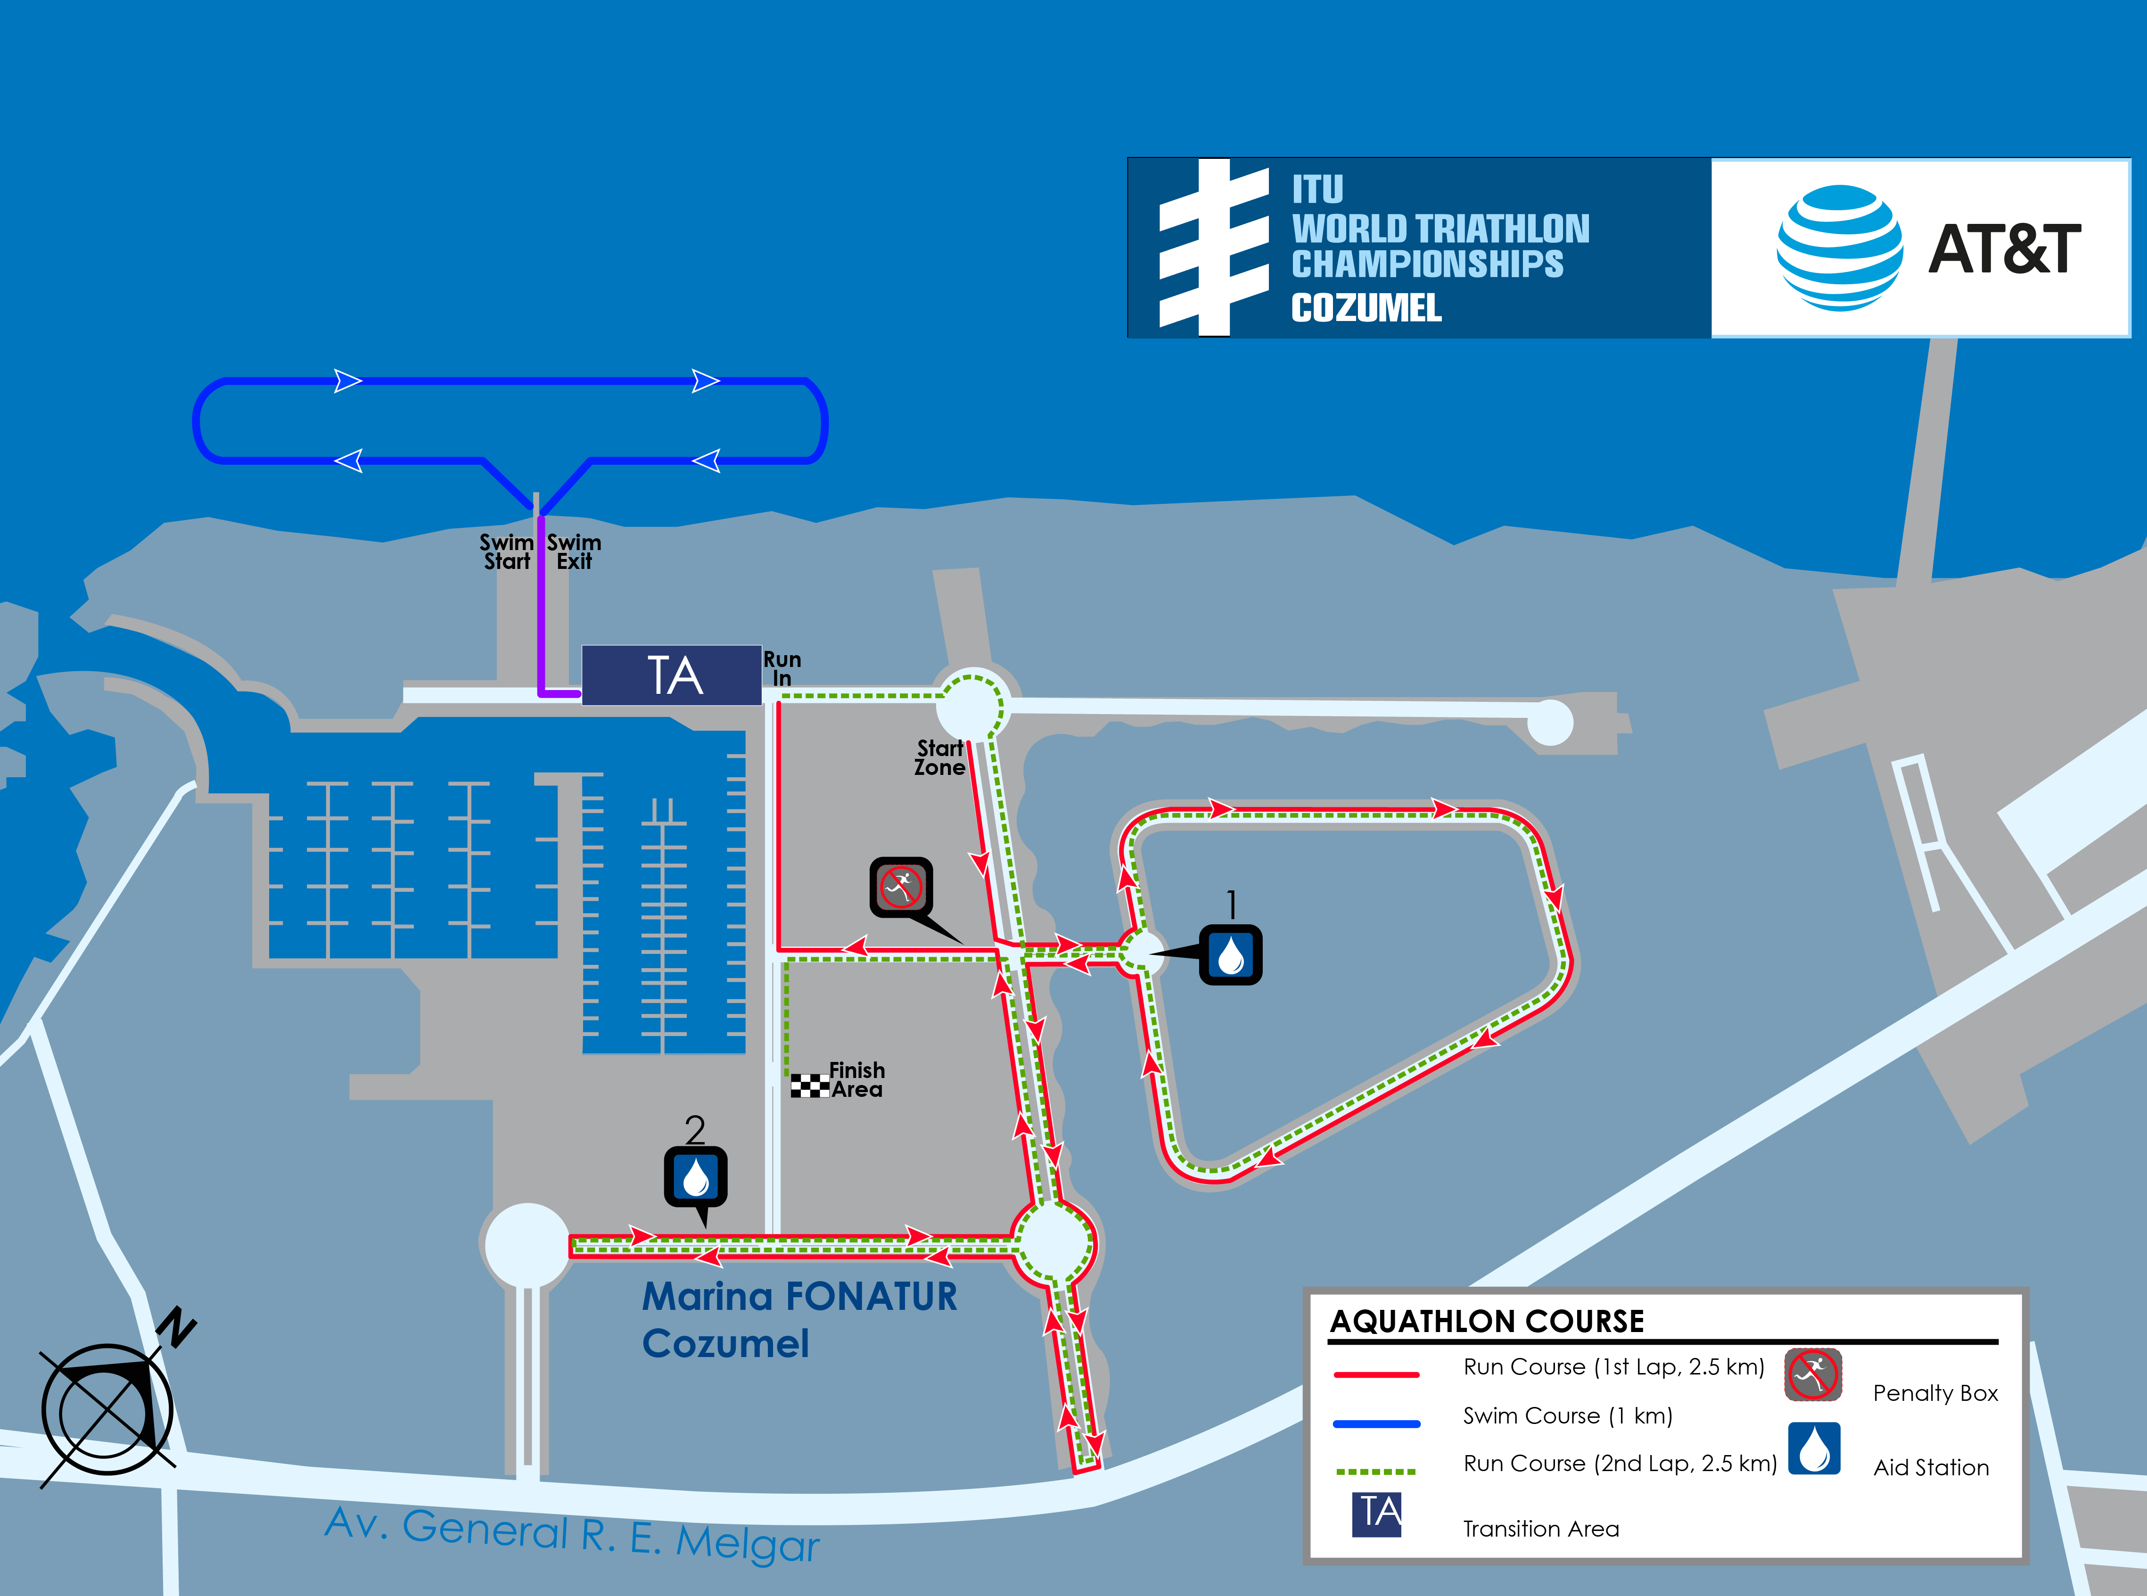
Aquathlon Course Map Overveiw

Slide 12
Pre-Start Procedure
Move into pre-start zones
Approx 20 minutes before start – move into pre-start zone located outside of Transition on the road.
Listen for announcements.
Ensure timing chip on left ankle.
Do not take non-essential equipment into start area including water bottles or clothing.
Athletes names will be announced and will move on to the start line.

Slide 13
Start Procedure
Athletes in position
The start can be given any time after the Race Referee announces ”On your mark”
Air horn blast .
The race starts.
Athletes not moving forward at the start will receive a time penalty of 10 seconds in TA1.

Slide 14
False Start Procedure
False start Example
Several horn blasts
Everyone goes back to her/his spot
Valid start but with early starters
If someone starts before the horn and everyone else starts with the horn, the false starter will receive a time penalty of 10 seconds at the penalty box on the first run. (During the time penalty athlete can not touch any equipment!)

Slide 15
Run 1 Course Map

Slide 16
Run Course
1 lap (total distance of 2.5 km)
Aid stations:
2 per lap For locations see the map
Water
Discard plastic bottles and litter in the Littering Zone (located directly after the Aid Stations)

Slide 17
Run Penalty Box
The penalty box is for infringements in: TA1, TA2 and littering
e..x.: discharge or store your equipment outside your designated area, etc.
(Transition will be videotaped for infringements)
Location: before last turn leading to finish/transition
Information: White board to show race numbers
(Athletes need to read the board)
Procedure: 10 seconds time penalty served on the Run.
If you don’t stop it will result in DSQ

Slide 18
Transition Area
All used equipment into your box
Not doing so → 10 second time penalty

Slide 19
1.0 km Swim Course Map

Slide 20
Swim Course
Yesterday - Water temperature: 26.6 °C
- Air temperature: 29 °C
distance to the first turn buoy 200 m
1 laps (total distance of 1.0 km) – clockwise
Pass first 6 turn buoys on your Right shoulder
Past last turn buoy on your left shoulder
Turn Bouys will be Yellow, sighting buoys will be Orange.
Swim behavior will be closely monitored, inc. video.
Place cap, and goggles into your transition area.

Slide 21
Run 2 Course Map

Slide 22
Run Course
1 lap (total distance of 2.5 km)
Aid stations:
2 per lap
For locations see the map
Sealed water
Discard plastic bottles and litter in the Littering Zone (located directly after the Aid Stations)
Photo-finish
Congestion in finish area:
Go to mixed zone / recovery area

Slide 23
Run Penalty Box
The penalty box is for infringements in: TA1, TA2 and littering
e..x.: discharge or store your equipment outside your designated area, etc.
(Transition will be videotaped for infringements)
Location: before last turn leading to finish/transition
Information: White board to show race numbers
(Athletes need to read the board)
Procedure: 10 seconds time penalty served on the Run.
If you don’t stop it will result in DSQ

Slide 24
Post-race procedure
Doping Control
Photo ID is needed for every athlete to go for testing
Team Medical Access
Only team medical will be allowed to enter the medical tent after ITU Medical Delegate’s permission.
Every NF can have 1 team medical accreditation, but for team doctors only!
Team doctors should register with the ITU Medical Delegate (Dr. Humberto Aguilar)

Slide 25
Post race procedure
For Top 3:
- TV/Flash Interviews
- Medal Ceremony
- Media “Mixed Zone”
Dress “up” – with race uniform (or country clothes) coaches assistance needed: Ambush marketing rules apply
Race caps/visors are allowed at the podium with maximum 1 sponsor logo with maximum height 4cm & total area 20cm²
Elite/U23/Jr Aquathlon 8:45 Fonatur Triathlon Park
Awards Ceremony
Para Aquathlon Awards Ceremony 20:00 Playa Mia Beach Club

Slide 26
Ambush Marketing
Ambush marketing is defined as:
“Deliberately using the opportunity of live television and
media photographers to acquire additional exposure for your sponsor product, apparel or brand.”
The consequence for this behavior is:
The athlete will immediately forfeit their prize money for that event, if any
Please follow the ambush marketing rules

Slide 27
Weather Forecasts
Wednesday
High/Lo Precipitation Wind Humidity
30°/ 24° 40% ESE 16 km/h 82%

Slide 28
Briefing presentation
http://www.triathlon.org/about/downloads/category/race_briefings/

