Slide 1
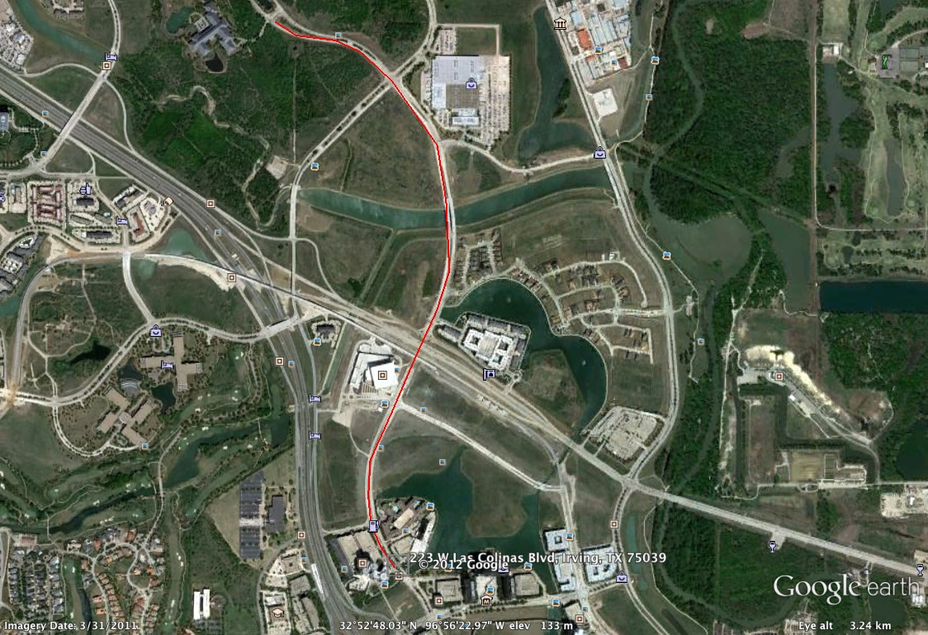
June 6th Dallas ITU Pan American Champs
Elites: 4 Loops
*3 mile out and back
- We have both sides of street from brune way to Lake Carolyn on Las Colinas Blvd.
We have the side closest to 114 from Lake Carolyn to Exxon on Las Colinas Blvd.
The car traffic is split two way down the other side of the street from Exxon to Lake Carolyn on Las Colinas Blvd.
Marriott
Bike Start/Finish

