Slide 1

Elite Athlete’s Briefing

Slide 2
Briefing agenda
Welcome and Introductions
Competition Jury
Schedules and Timetables
Check-In and Procedures
The Course
Post-Race Procedures
Weather Forecast

Slide 3
Welcome and Introductions
Leslie Poujol Brown(HON), ITU Technical Delegate
Roberto Segura(PER), ATD Assistant Technical Delegate
Schubert Abreu (BRA) – ITU Head Referee
Felix Molina (MEX) – ITU Team Leader
Humberto Aguilar (MEX) – ITU Medical Delegate
Rodrigo Leon Prado, President Peruvian Triathlon Federation

Slide 4
Competition Jury
Leslie Poujol Brown – ITU-TD
Liber Garcia – PATCO President
Rodrigo Leon Prado – President Peruvian Federation

Slide 5
Schedule and Timelines
Saturday, Nov. 2nd – Familiarizations
11:30 Coaches bus departs Hotel Casa Andina
12:00 Police Escorted caravan departs Nobility Hotel and Hotel Casa Andina
12:45 Bike Familiarization
13:30 Swim Familiarization
PLEASE DO NOT RIDE YOUR BIKES UNLESS ESCORTED

Slide 6
Schedule and Timelines
Sunday, Nov. 3rd – Ecorted Ride to Venue
06:50 FEMALE Elite Athletes - Police Escorted caravan departs Nobility Hotel and Hotel Casa Andina
~ 07:15 Female Elite Athletes Arrive Venue
08:25 MALE Elite Athletes - Police Escorted caravan departs Nobility Hotel and Hotel Casa Andina
~08:50 Male Elite Athltes Arrive Venue
PLEASE DO NOT RIDE YOUR BIKES UNLESS ESCORTED

Slide 7
Schedule and Timelines
Sunday, Nov. 3rd – FEMALE Individual Event
07:15 – 08:30 Athletes’ Lounge open/close
08:00 – 08:45 Transition Area open/close
08:15 – 08:45 Swim Warm-up
08:50 Athletes Line-up and Introductions
09:00 Elite Females Start
12:30 Medal ceremony

Slide 8
Schedule and Timelines
Sunday, Nov. 3rd – MALES Individual Event
09:15 – 10:30 Athletes’ Lounge open/close
10:00 – 10:45 Transition Area open/close
10:15 – 10:45 Swim Warm-up
10:50 Athletes Line-up and Introductions
11:00 Elite Males Start
12:30 Medal ceremony
Male athletes to enter venue at South Entrance.
No riding on Field of Play

Slide 9
Race Morning Check-In Procedures
Athletes Lounge
  Final check of Uniform & race gear (name, country, logos, ITU logo) – match photos taken of each uniform from previous check. Wearing other uniform during the race = DSQ!
  Body marking check (both arms, both legs)
  Timing chip distribution (1 for each ankle)
  Swim cap distribution
  If an athlete wishes to wear a second swim cap, the cap must be unbranded and worn underneath at all times to T1.

Slide 10
Check-in procedures
Transition Area
  Helmet check- Don’t leave your helmet fastened in the transition
  The athlete who misses to comply with this rule will receive a time penalty in TA1.
  Running Shoes outside the box, helmet on the bike
  To add any equipment to the bike, you must obtain approval from the Head Referee up until 10 minutes after the end of the Athletes‘ Briefing.

Slide 11
Pre-start Procedure
Athlete Introduction:
10 minutes before start - line-up in Transition area under the Finish Line gantry.
Wait for name to be called - jog to the platform (about 100 meters).
Select your position and stay behind the line!
Athlete’s are required to wear the official swim cap from the moment of the athletes’ line-up

Slide 12
Start Procedure
Athletes in position:
The start can be given any time after the TD announces ”On your mark”
Air horn blast
The race starts
Athletes not moving forward at the start will receive a time penalty in TA1.

Slide 13
False Start Procedures
False start with many athletes:
Several horn blasts
Kayaks move in front of you
Everyone goes back to her/his original start spot
Valid start with early starters:
If a few athletes start before the horn and everyone else starts with the horn, the false starter(s) will receive a 10 second penalty in TA1.
During the time penalty, the athlete(s) may NOT touch any equipment.

Slide 14
Swim Conduct
Definition from the ITU CRs 4.1:
e.) Athletes may sportingly maintain their own space in the water:
(i) Where athletes make accidental contact in the swim and then immediately afterwards move apart no penalty will be incurred;
(ii) Where athletes make contact in the swim, and an athlete continues to impede the progress of the other athlete without moving apart, this action will result in a time penalty;
(iii) Where athletes deliberately target another athlete to impede their progress, gain unfair advantage and potentially cause harm will result in disqualification and may be reported to ITU Arbitration Tribunal for potential suspension or expulsion.

Slide 15
Swim Conduct
Definition from the ITU CRs 4.1:
There will be boats and Technical officials deployed on the swim course to monitor athlete’s behaviour in this respect .
Infringements will be recorded and appropriate action will be taken based on the rules definition from the previous slide .
Please respect your fellow competitors and keep the race fair.

Slide 16
Swim Course
Swim
1 laps = 750m
Bike
4 laps x 5km = 20km
Run
2 laps x 2.5km = 5km

Slide 17
Swim course - Individual
Water temperature: water temperature~19C
                air temperature ~22°C
Wetsuits mandatory at 15.9C or below
2 laps (~750m per lap)
Distance to first buoy ~ 360m
Clockwise
Cap and goggles must be taken to transition and dropped into your box.

Slide 18
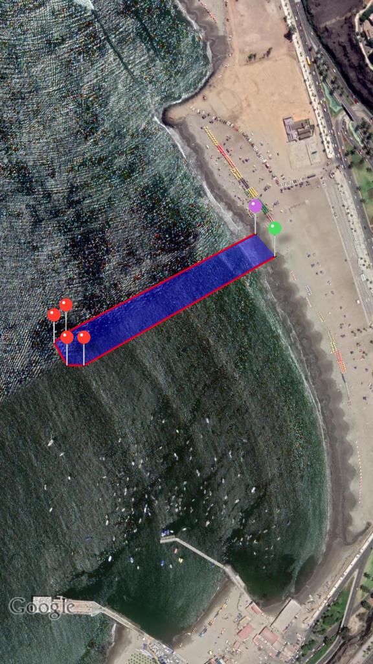
Swim Start
Swim Exit
Buoy
4
3
2
1
340m

Slide 19
Swim course
Water temperature: water temperature~19C
                air temperature 22°C
Wetsuits mandatory at 15.9C or below
1 lap – 750 m
Distance to first buoy 340 m
Clockwise
Cap and goggles must be taken to transition and dropped into your box.

Slide 20
Transition Area
Swim Exit to TA 120m
Individual Bike Racks
Running shoes in front of the box, helmet on the bike
Bags to the Athletes Lounge
  All used equipment into the box
Mount line at the end of the TA

Slide 21
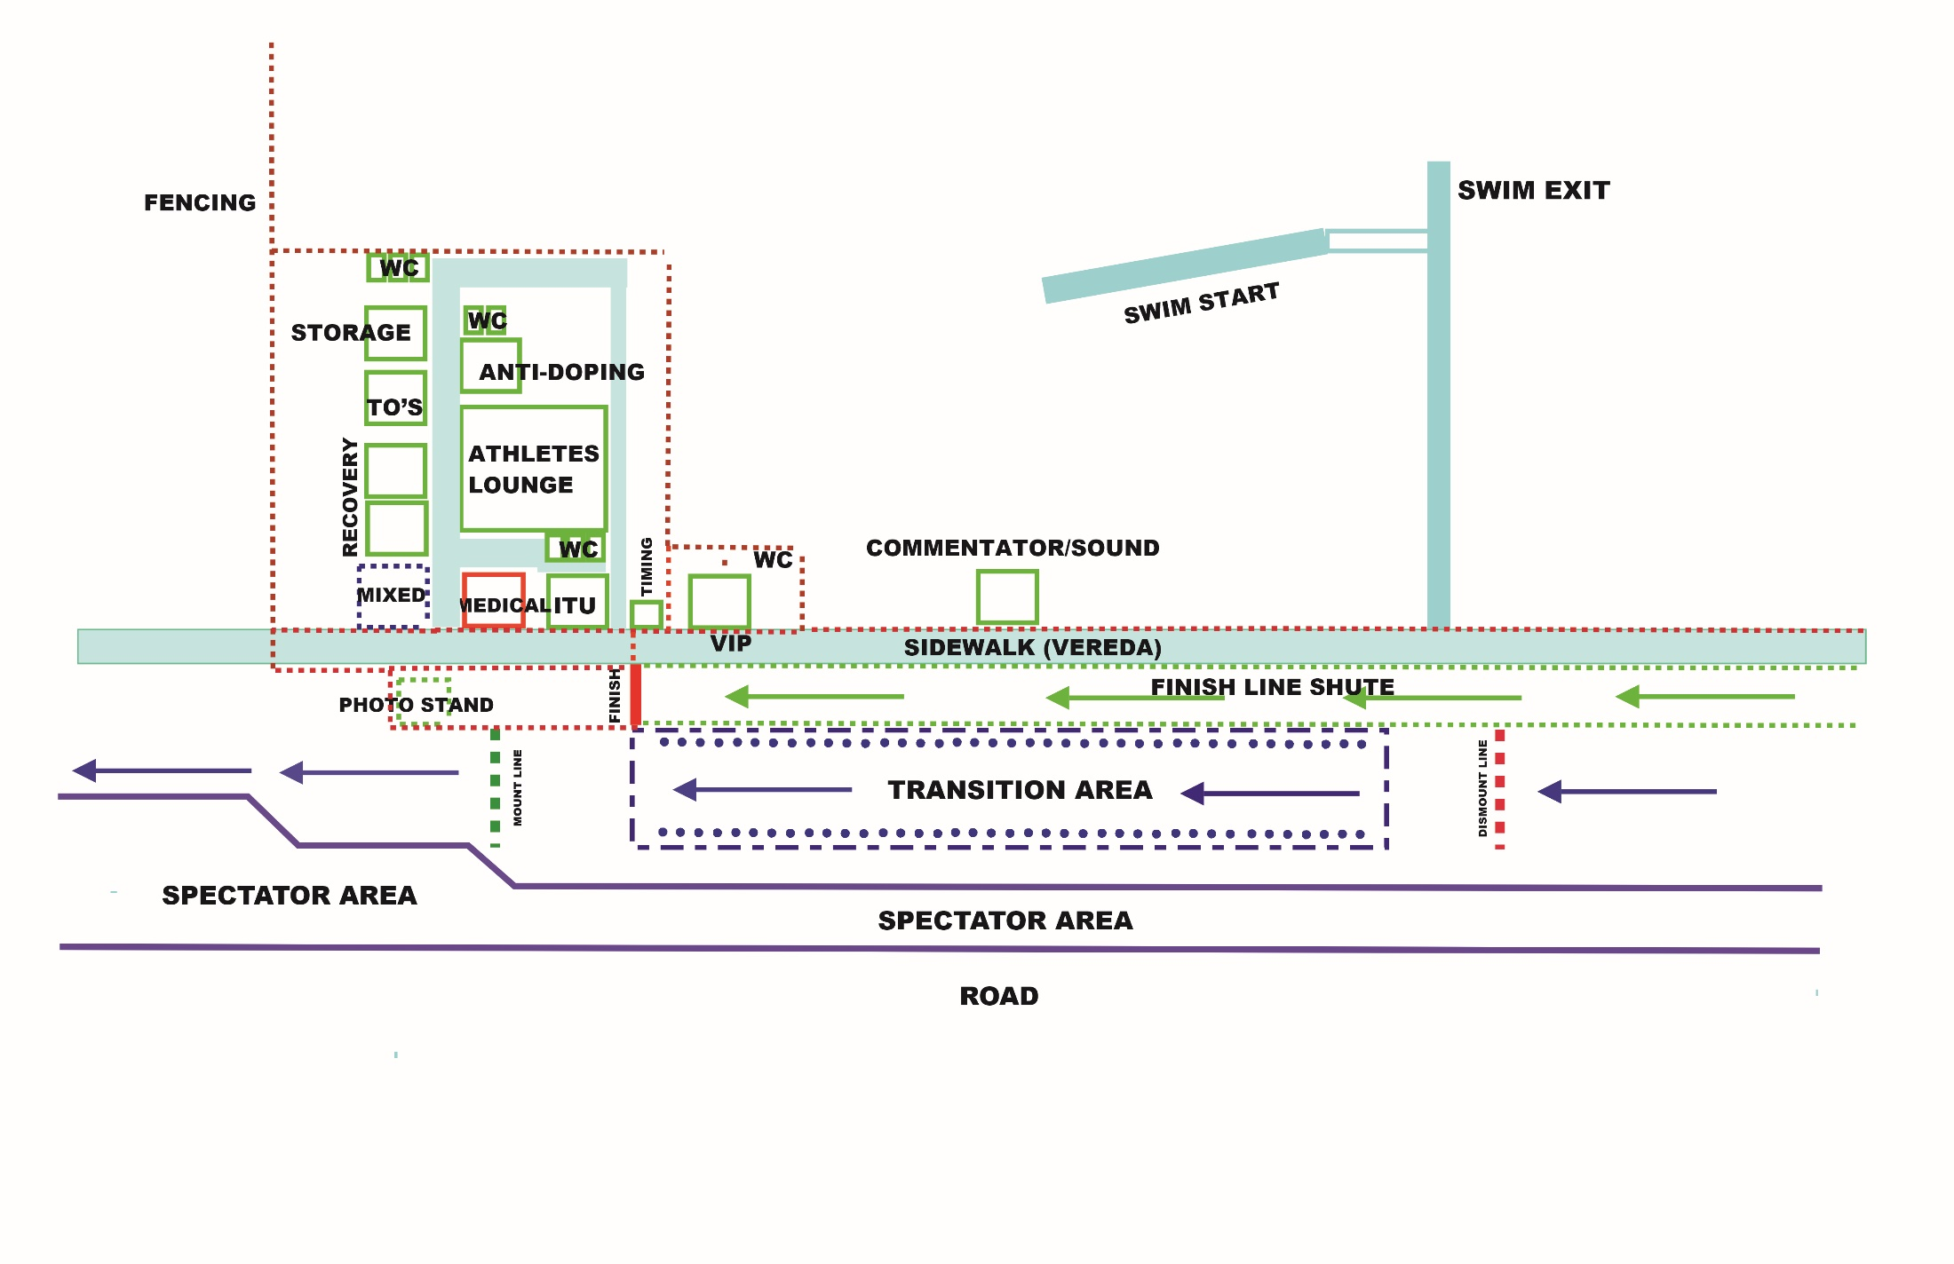
Transition Flow and Venue Layout

Slide 22
Bike Course
4 laps x 5.27 = 21.10 km
One steep hill, with someTechnical sections.
Caution on all corners if road is wet.
1 Team wheel station which you can access 2 times per lap at bottom of hill, on median.
1 Neutral Wheel Station near turn around on North side of course.
Lap Counter: after leaving Transition
The Lap Out rule WILL be in effect in this race.

Slide 23
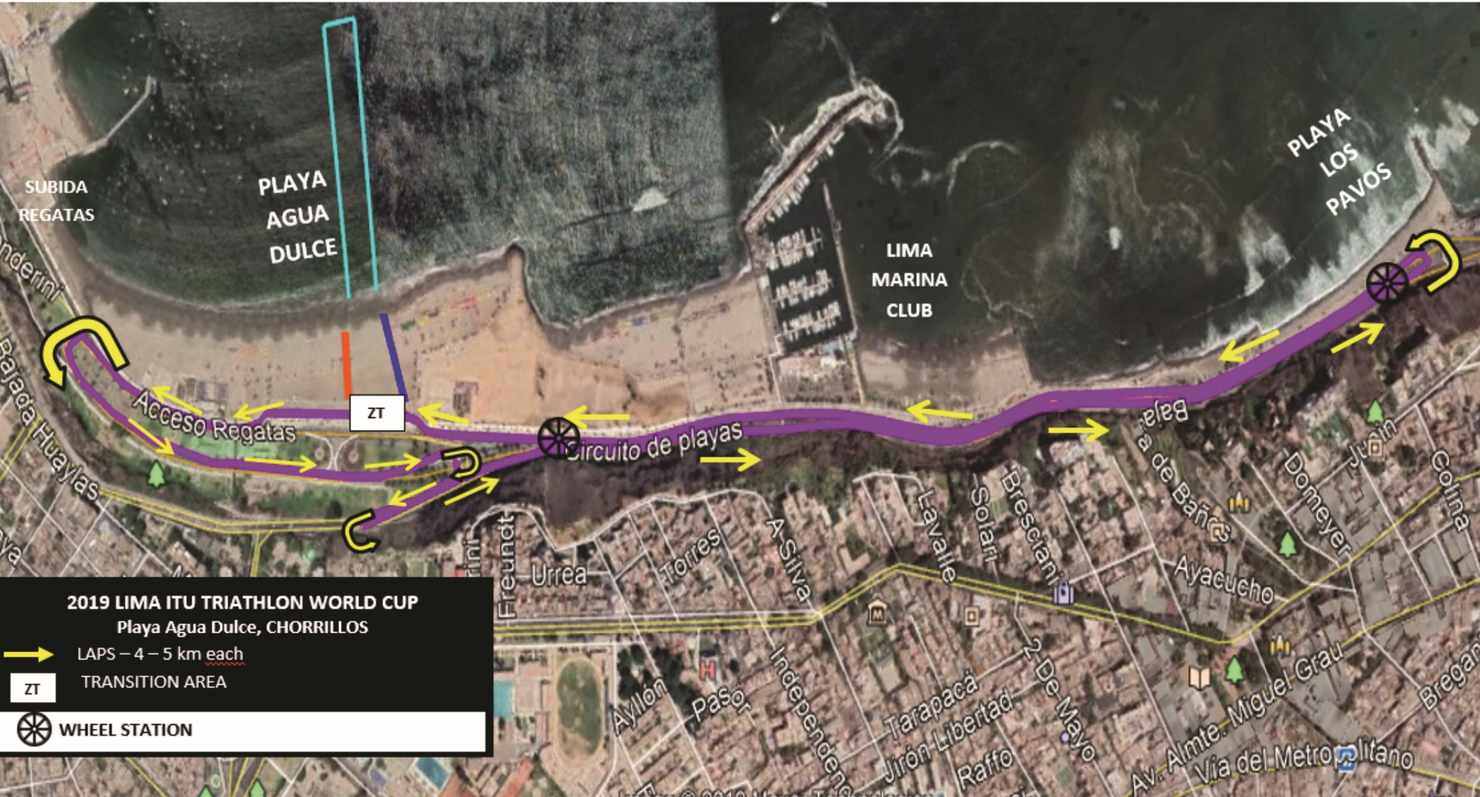
Bike Course Map
FIRST RUNNER LAST BIKER SCENARIO

Slide 24
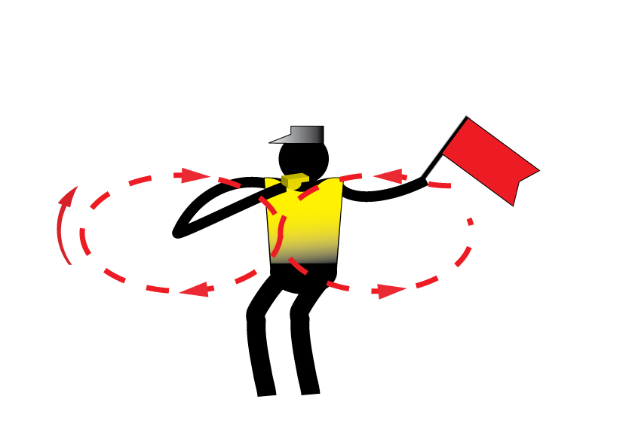
Caution
Caution signal: three sharp whistles and red flags

Slide 25
Run course
2 laps – 5 km
Northbound run lane is next to median on road. You will return on beach side of road.
Aid stations:
  2 per lap
  Sealed water
  Discard plastic bottles within the littering zones. (20m before and approx. 80m after Aid stations)
  Video Finish
      Congestion in finish area:
    Go to mixed zone / recovery area

Slide 26
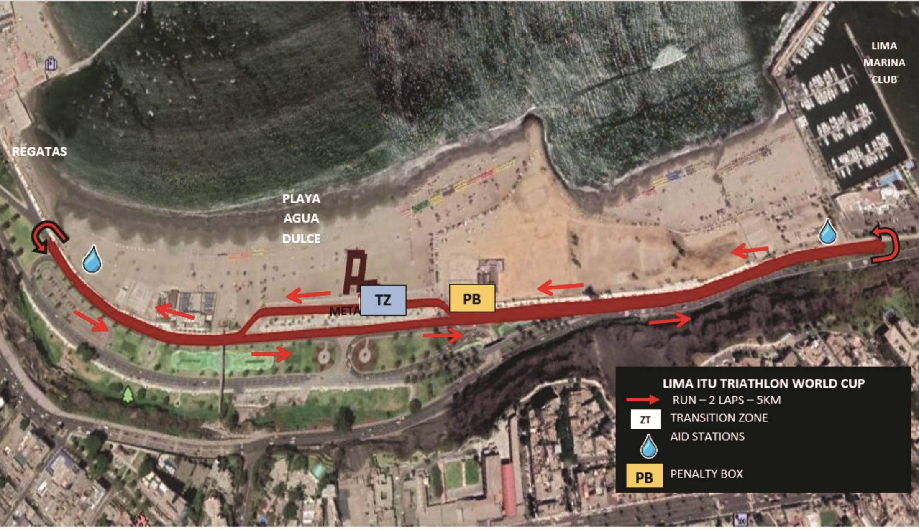
Run Course Map

Slide 27
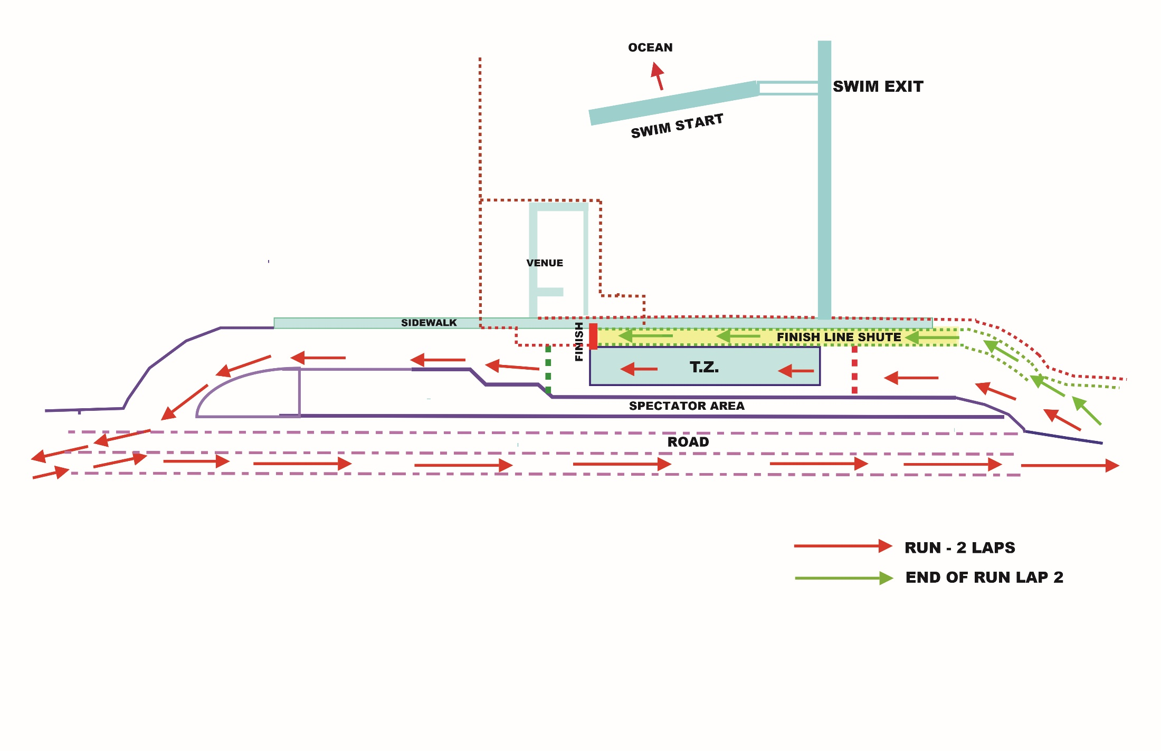
Run Lap

Slide 28
Run Penalty Box
Refer to 3.3 on the Competition Rules
Start infringements will be served in T1
Swim, T1, Bike, T2 and Run Infringements will be served in Run Penalty Box
(Transition will be videotaped for infringements)
Location: Before the finish line as you enter the venue from the main road.
Information: White board to show race numbers and letter codes to indicate violations
  (Athletes need to read the board – coaches are advised to check and inform their athletes)
Procedure: 10-second time penalty served on any lap of the run (Transition and run infringements)
Athletes have the option to decide whether to stop at the penalty box and serve the penalty or continue to the finish. Not stopping will result in DSQ on crossing the finish line. The athlete may then appeal the penalty. Evidence will only be made available if an appeal is filed.

Slide 29
Run Penalty Box
Rule interpretation
Mount after the mount line: An athlete’s foot must contact the ground past the mount line, before the athlete mounts the bike. If this contact doesn’t occur, it is considered an infringement of the rules (M).
Dismount before the dismount line: An athlete’s foot must contact the ground before the dismount line after the athlete dismounts the bike. If this contact doesn’t occur, it is considered an infringement of the rules (D).
Discharge or store your equipment inside your designated area: Leaving the equipment (swim cap, goggles, helmet, etc.) in the designated box. If leaving the equipment outside the box, it is considered an infringement of the rules (E).

Slide 30
Run Penalty Box
Violations Abbreviations:
Littering: L Mount Line: M
Swim violations: S Dismount Line: D
Other violations: V Equipment outside box: E
For example:
12D = athlete #12 received a time penalty for a dismount line violation
2x12ME = athlete #12 received 2-time penalties for mount line and equipment outside the box violations

Slide 31
Post-race Procedures
Mixed Zone
Medal Presentation – chaperones will lead you to the ceremony.
Separate ceremonies for both Women and Men winners
Follow the ambush marketing rules
Dress “up”

Slide 32
Ambush Marketing Rules
Ambush marketing is defined as:
“Deliberately using the opportunity of live television and media photographers to acquire additional exposure for your sponsor product, apparel or brand.”

Slide 33
Post-race Procedures
Anti-Doping Control
  Photo ID is needed for every athlete to have ready for Doping Control
Team Medical Access
  Only team medical will be allowed to enter the medical tent after the LOC Doctor’s perimission.

Slide 34
Coaches areas
Accreditation
All coaches have to collect accreditation to be able to enter the Athletes Lounge and Coaches Areas.
Only Coaches who have been registered from their NF into the ITU online system are entitle for an accreditation
Coaches’ areas:
Athlete’s Lounge
Swim Start
Penalty Box

Slide 35
Weather forecast
SUNDAY, November 3rd
High 21 C – Low 16 C
Sunny with partial clouds

Slide 36
Good Luck!

