Slide 1
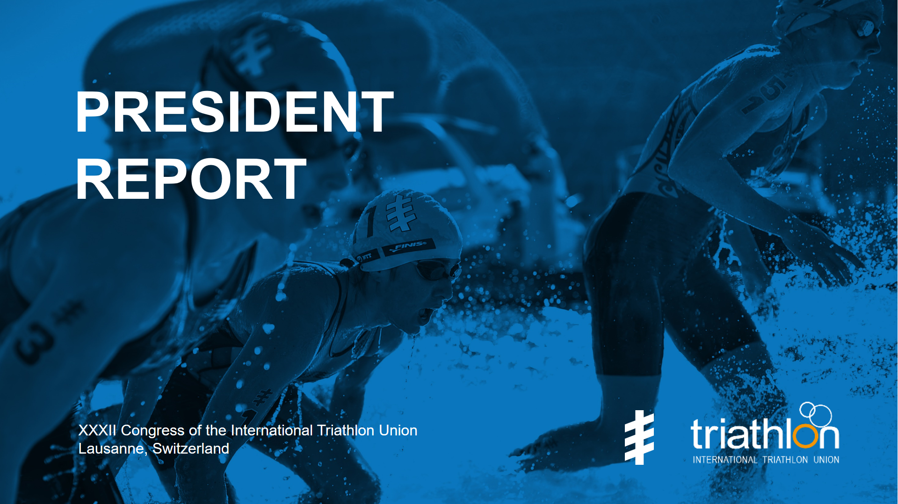

Slide 2
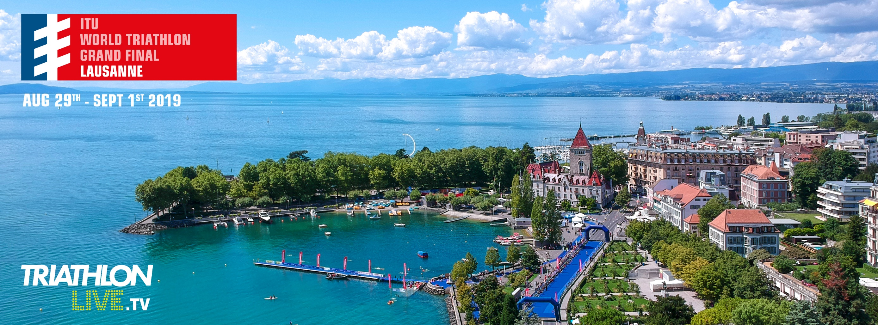
Welcome to the Olympic capital!

Slide 3
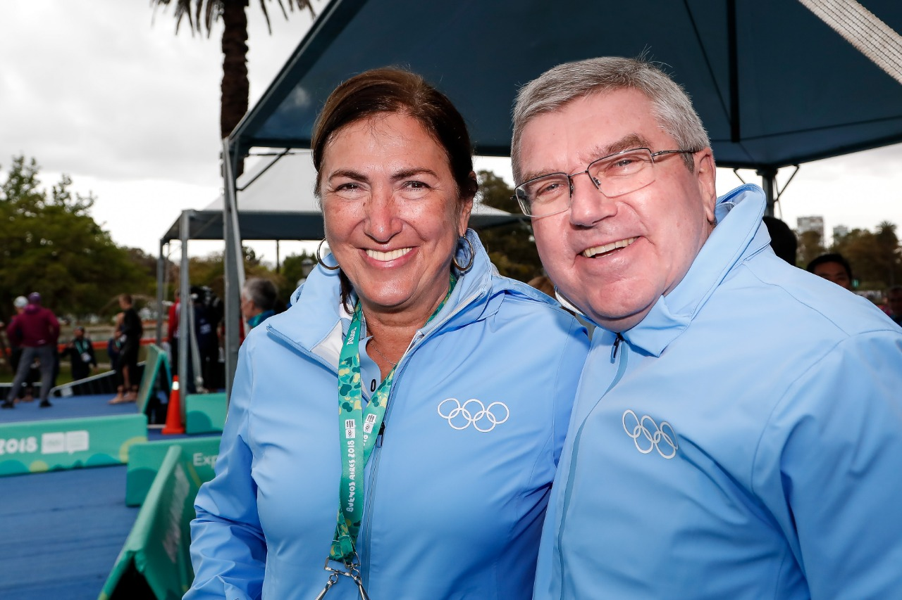
STRONG COOPERATION WITH IOC

Slide 4
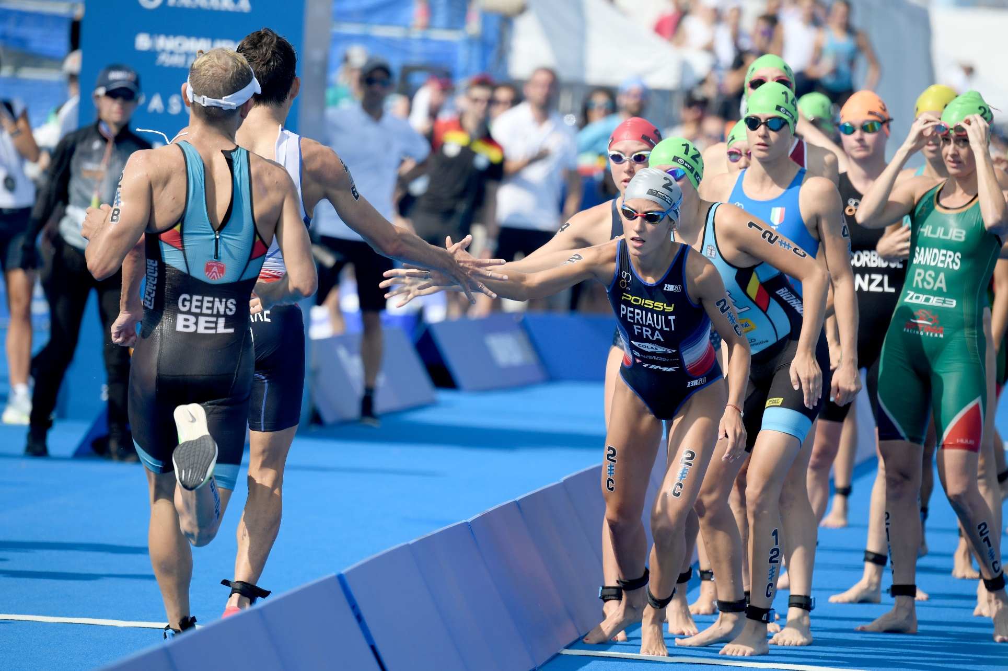
ATHLETES FIRST

Slide 5
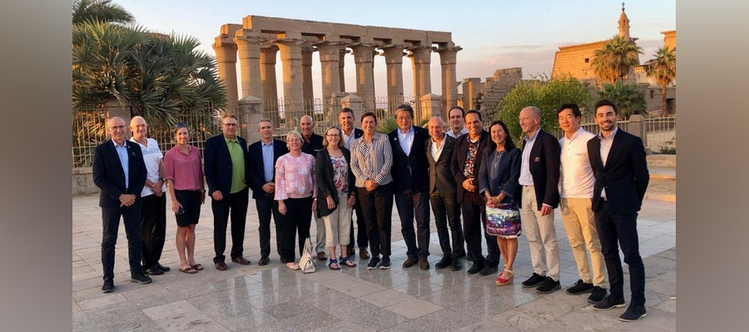
ATHLETES VOICE IN THE EB

Slide 6
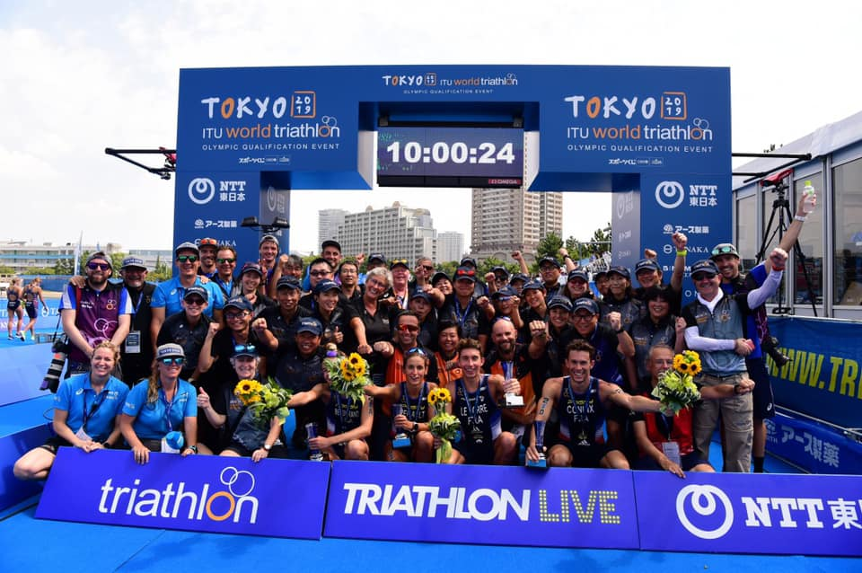
MORE FEMALE OFFICIALS

Slide 7
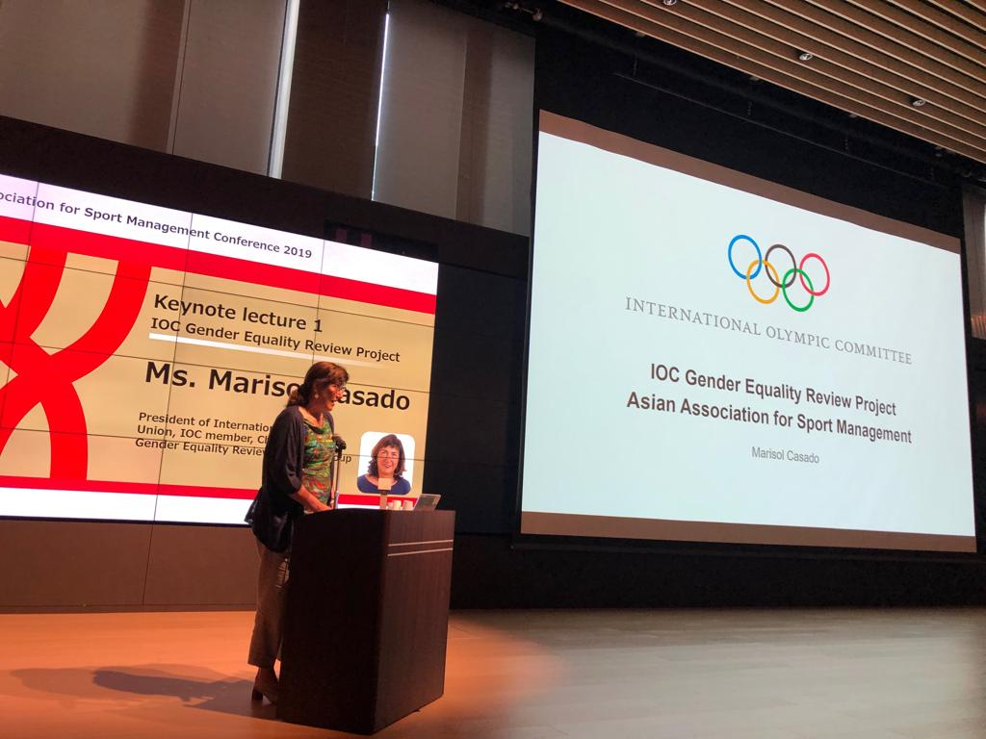
WOMEN EMPOWERMENT

Slide 8
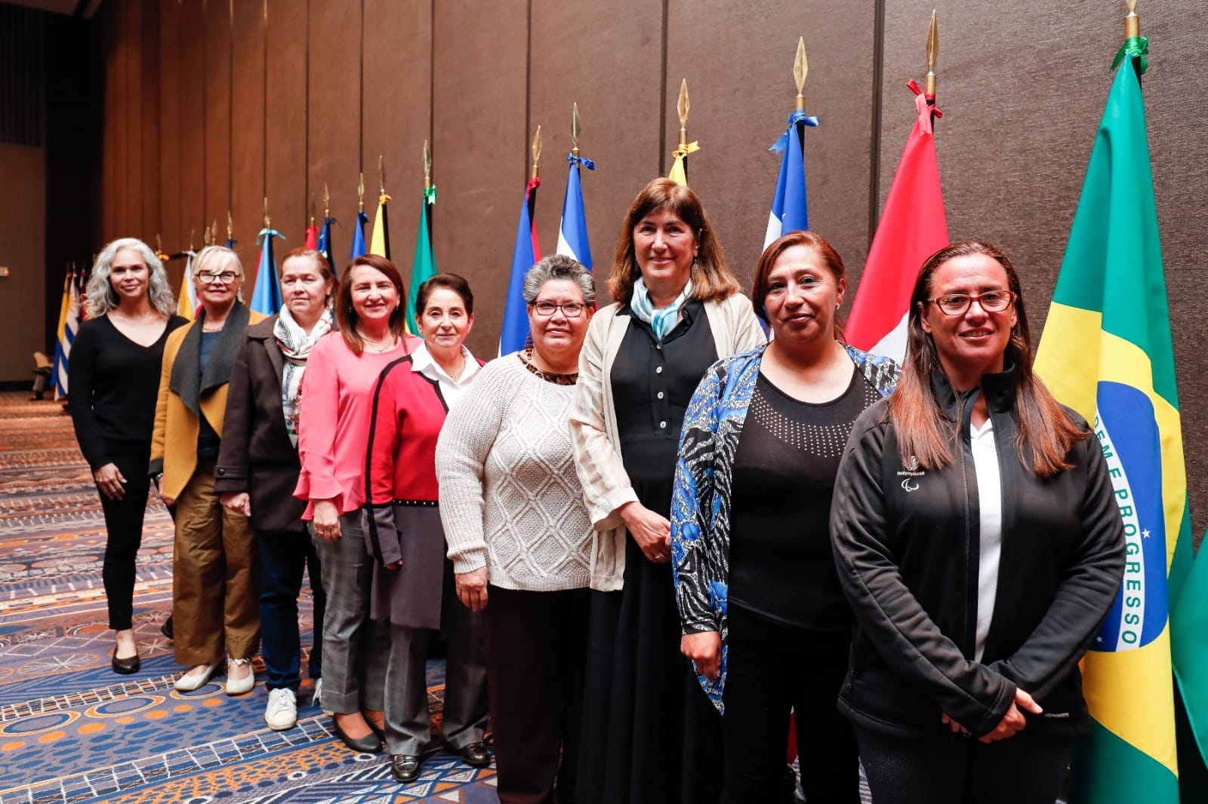
WOMEN EMPOWERMENT

Slide 9
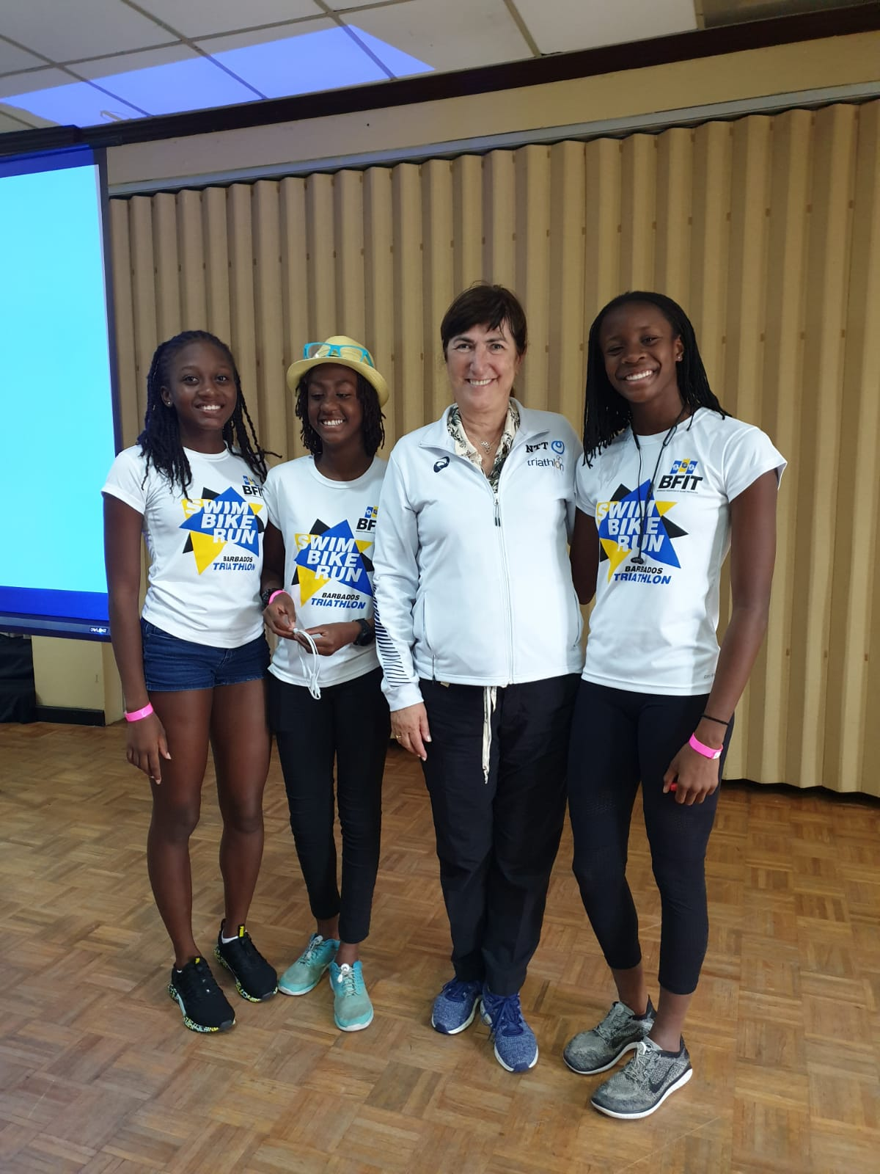
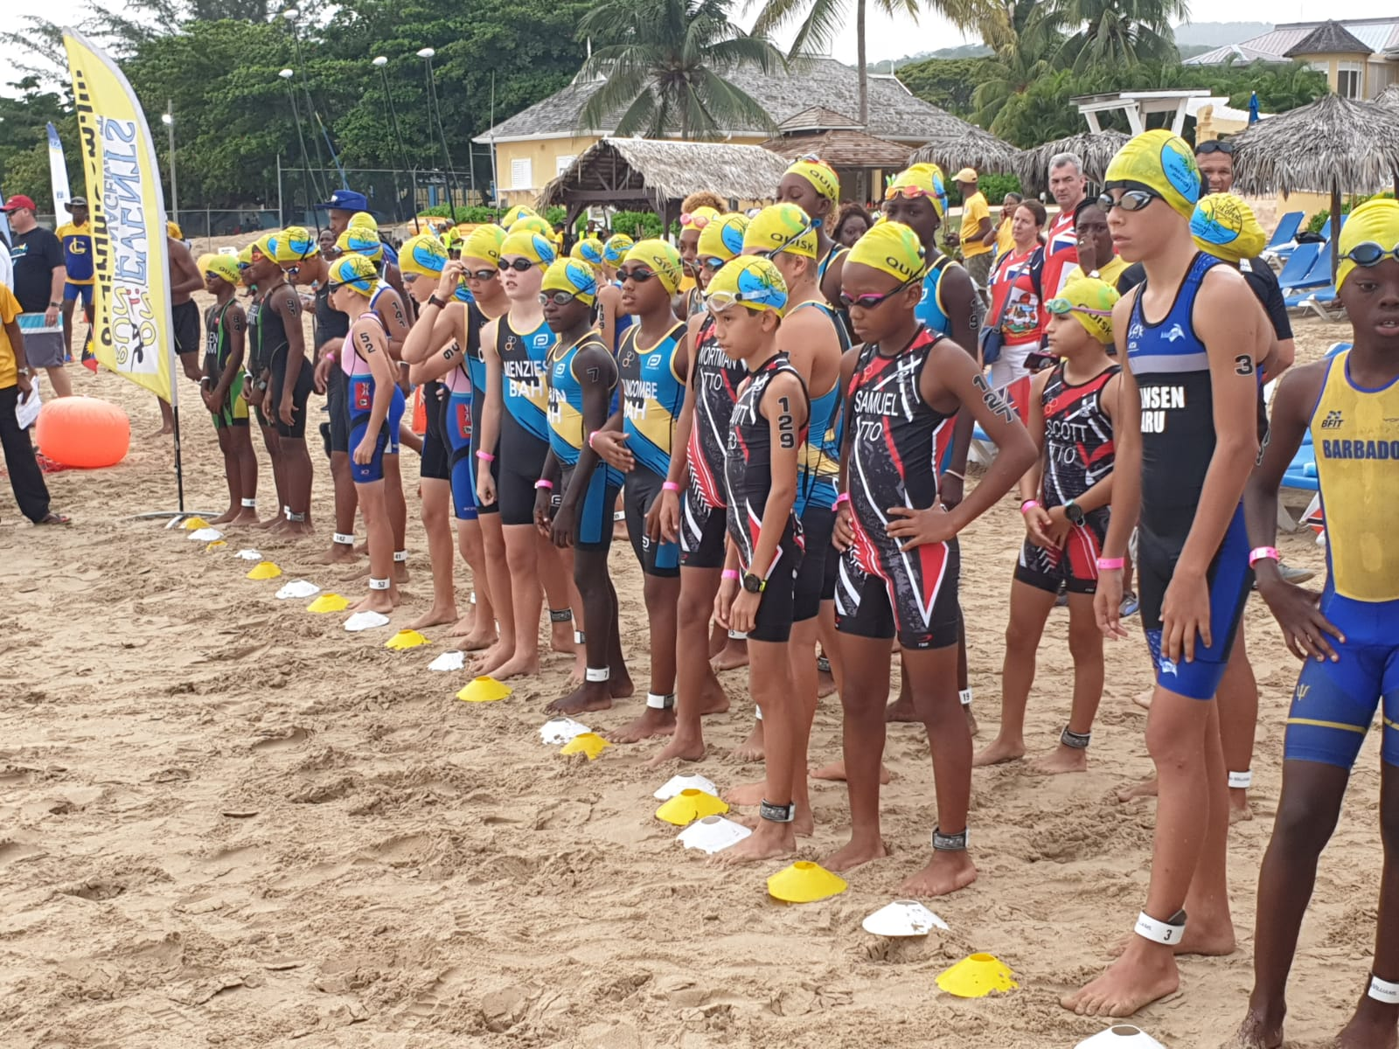
WOMEN & youth EMPOWERMENT

Slide 10
Finances → Prize money &development

Slide 11
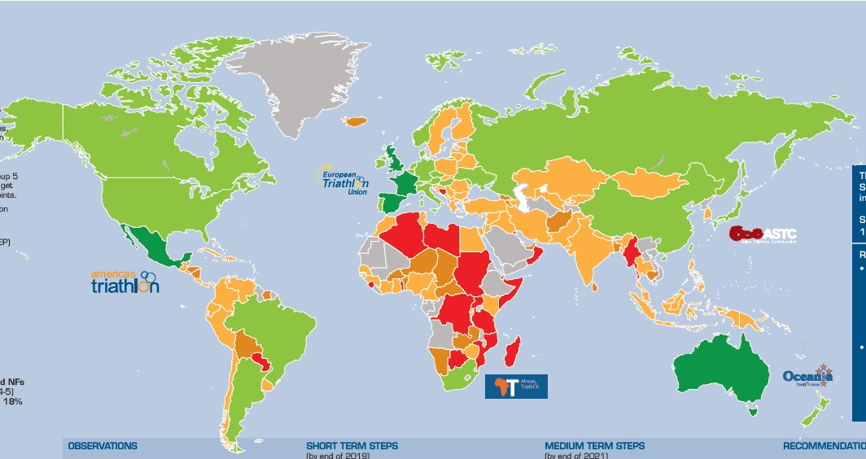
NATIONAL FEDERATIONS SURVEY

