Slide 1
Branding instructions to complete your briefing
Use ONLY Arial font. No other font should be used. Minimum font size = 20pt
The template has predefined brand colors. Try to use these colors before any others.
Only the official World Triathlon event logo can be placed on this briefing and no others. Please get it from your LOC. The one on the cover should be on the white version on transparent background
Only use the front cover given to you
You can apply different predefined layout for the text slides but the above must be respected
If you need to highlight some information, use the Blue Text 1 from the World Triathlon color palette

Slide 2
Elite Athletes’ briefing
<insert date of briefing>
Insert official World Triathlon event logo, white version
Notes:
A quick guide to introduce you to the various elements that make up the presentation template.
Brand fonts
Arial is our secondary brand font and should be available organisation-wide.
Brand colours
Our colours have been carefully chosen to engage and represent the world of triathlon, appealing to new audiences and resonating with long-time participants. To achieve this, it is important that they are used both carefully and accurately.
The colours have been set up within the theme of this template.
Charts and tables
Using PowerPoint’s default table and chart styles will pull our on-brand colours through automatically.
Colours should be kept flat with no gradients or shadows.
Get started
Click on the drop-down arrow next to the new slide button at the top to reveal the full suite of slides available.

Slide 3
Agenda
Welcome and Introductions
Competition Jury
Schedules and Timetables
Check-in and Procedures
The Course
Post-Race Procedures
Water Quality Test Results
Weather forecast

Slide 4
Welcome and Introductions
<Insert name>, <highest ranked World Triathlon/ Continental Executive Board representative>
<Insert name>, World Triathlon Team Leader {if applicable}
<Insert name>, World Triathlon Technical Delegate
<Insert name>, World Triathlon Assistant Technical Delegate {if applicable}
<Insert name>, World Triathlon Medical Delegate {if applicable}
<Insert name>, World Triathlon Head Referee
<Insert name>, LOC Director
{comment – to be deleted: Insert the names of the officials that are attending the briefing and delete the rest}
Insert official World Triathlon event logo,
color version

Slide 5
Competition Jury
<Insert name>, Chair
<Insert name>
<Insert name>
{comment – to be deleted: Insert the names of the Competition Jury Members, add two more member for World Triathlon Series Grand Final elite competitions}
Insert official World Triathlon event logo,
color version

Slide 6
Schedule and Timetables
FRIDAY {Thursday if the briefing is on Thursday}
hh:mm – hh:mm Race pack pick-up (after athletes’briefing)
Your package includes:
- Stickers – Helmet (3x), Bike (1x), Bag (1x) Stickers
- Body decals – both arms and both legs {if applicable}
- Accreditation - gives access to access lounge on race day
hh:mm – hh:mm Pasta Party {if applicable}
Insert official World Triathlon event logo,
color version

Slide 7
Schedule and Timetables
SATURDAY {Friday if the briefing is on Thursday}
hh:mm – hh:mm Training sessions in the swimming pool {if applicable}
hh:mm – hh:mm Bike course familiarisation {if applicable}
Meeting point: <insert meeting point>
hh:mm – hh:mm Swim course familiarisation {if applicable}
Insert official World Triathlon event logo,
color version

Slide 8
Schedule and Timetables
SUNDAY {Saturday if the briefing is on Thursday}
hh:mm – hh:mm Athletes’ Lounge check-in Elite Women
hh:mm – hh:mm Transition Area check-in for Elite Women
hh:mm – hh:mm Swim Warm-up for Elite Women
hh:mm Athletes’ Introduction
hh:mm Elite Women Start
hh:mm – hh:mm Medal ceremony
{comment – to be deleted: Additional information can be added}
Insert official World Triathlon event logo,
color version

Slide 9
Schedule and Timetables
SUNDAY {Saturday if the briefing is on Thursday}
hh:mm – hh:mm Athletes’ Lounge check-in Elite Men
hh:mm – hh:mm Transition Area check-in for Elite Men
hh:mm – hh:mm Swim Warm-up for Elite Men
hh:mm Athletes’ Introduction
hh:mm Elite Men Start
hh:mm – hh:mm Medal ceremony
hh:mm Closing ceremony {if applicable}
{comment – to be deleted: Additional information can be added such as «buses leave for the closing ceremony from ….. at hh:mm»}
Insert official World Triathlon event logo,
color version

Slide 10
Check-in procedures
{if applicable}
Team officials entering the venue
Using the shuttle service from the ……………
Schedule
<pickup location> to <drop off location>: hh:mm, hh:mm, hh:mm,
<pickup location> to <drop off location>: hh:mm, hh:mm, hh:mm,
Insert official World Triathlon event logo,
color version

Slide 11
Check-in procedures
Athletes’ Lounge
Uniform & race gear check (name, country, logos, World Triathlon logo, zippers) – photos taken of each uniform. Wearing other uniform during the race = DSQ
Body marking check (both arms, both legs)
Timing chip distribution (1 for the ankle/ 2 for each ankle choose the correct)
Swim cap distribution
If an athlete wishes to wear a second swim cap, the cap should be unbranded.
Leave your bag in the Athletes’ Lounge they will be taken to the Recovery Area {if applicable}
Insert official World Triathlon event logo,
color version

Slide 12
Check-in procedures
Transition Area
Bike check (Bike mechanic available) The maximum tyre diameter for the MTB is 29 inch The minimum cross section is 1.5 inch
Fix the MTB handlebar name plate will be placed on the bike’s handlebar on each athletes’ bike. Finishing without a plate is subject to DSQ.
Helmet check - Don’t leave your helmet fastened in the transition
Handlebars: Clip-on handlebars are forbidden + Traditional MTB bar ends are allowed but must be plugged
Running Shoes outside the box, helmet on the bike
To add any equipment to the bike, you must obtain approval from the Head Referee up until 10 minutes after the end of the Athletes‘ Briefing {or race pack distribution in events under COVID-19 measures}.
Insert official World Triathlon event logo,
color version

Slide 13
Pre-start Procedures
Athlete Introduction
10 minutes before start - line-up {insert location}
Jog to the start platform once your name is called
Select your position and stay behind the line!
Athlete’s are required to wear the official swim cap from the moment of the athletes’ line-up
Athlete blocking more than one place will result DSQ
Insert official World Triathlon event logo,
color version

Slide 14
Pre-start Procedures – Line-up map
<Insert line up map, if applicable>
Insert official World Triathlon event logo,
color version

Slide 15
Start Procedures
Athlete in position
The start can be given any time after the TD/ HR {choose the correct} announces ”On your mark”
Electronic horn blast / Air horn blast {choose the correct}
The race starts
Athletes not moving forward at the start will receive a 10/15 seconds time penalty in TA {choose the correct}.
Insert official World Triathlon event logo,
color version

Slide 16
False-start Procedures
False-start (many athletes)
Several horn blasts
Kayaks move in front of you
Everyone goes back to her/his original start spot
Valid start with early starters
If a few athletes start before the horn and everyone else starts with the horn, the false starter(s) will receive a 15/10 seconds {choose the correct} time penalty in TA1. During the time penalty, the athlete(s) may NOT touch any equipment.
Insert official World Triathlon event logo,
color version

Slide 17
The course
Swim <number> lap(s) of <lenght of one lap>m
Bike <number> laps of <lenght of one lap>km
Run <number> laps of <lenght of one lap>km

Slide 18
The course
<Insert overall course map>
Insert official World Triathlon event logo,
color version

Slide 19
Swim course
On {date} at {hh:mm}: <water temperature> °C
<air temperature> °C
Wetsuit allowed / Wetsuit not allowed {choose the correct or mention decision taken 1h before the race}
<number of laps> laps (total distance of <total length of the swim in meter>m)
Distance to the first turn buoy <length in meter>m
Take cap, goggles to transition into your box
Swim cut-off – as per World Triathlon competition rules
Insert official World Triathlon event logo,
color version

Slide 20
Swim conduct
Definition from the World Triathlon CR §4.1:
e.) Athletes may sportingly maintain their own space in the water:
Where athletes make accidental contact in the swim and then immediately afterwards move apart no penalty will be incurred;
Where athletes make contact in the swim, and an athlete continues to impede the progress of the other athlete without moving apart, this action will result in a time penalty;
Where athletes deliberately target another athlete to impede their progress, gain unfair advantage and potentially cause harm will result in disqualification and may be reported to World Triathlon Arbitration Tribunal for potential suspension or expulsion.
Insert official World Triathlon event logo,
color version

Slide 21
Swim conduct
There will be additional boats and Technical officials deployed on the swim course to monitor athlete’s behaviour in this respect .
Infringements may be recorded and appropriate action will be taken dependant on the rules definition from the previous slide .
Please respect your fellow competitors and keep the race fair.
Insert official World Triathlon event logo,
color version

Slide 22
Swim course map
<Insert Swim Course Map>
Insert official World Triathlon event logo,
color version

Slide 23
Swim exit to TA
<Insert Swim Exit to TA Map>
Insert official World Triathlon event logo,
color version

Slide 24
Transition Area {first choice}
Traditional Bike Racks – one row / two rows {choose the correct}
Rack your MTB by the saddle
Running shoes in front of the box, helmet on the bike
Bags to the Athletes Lounge
Wetsuits {if applicable}, googles & swim caps into the box
Mount line at the end of the TA
Insert official World Triathlon event logo,
color version

Slide 25
Transition Flow
<Insert Swim Exit to TZ Map, show where #1 is on the map for TA1 and TA2>
Insert official World Triathlon event logo,
color version

Slide 26
Bike course
<number of laps> laps (total distance of <total length of the bike in kilometer>km)
Hilly / flat and technical / not technical {choose the correct}
Course is marked according to the UCI MTB guidelines
Drafting is allowed in all the categories, but not between men and women
When safe, give way to faster riders. Stay on the right/left – Pass on the left/right {choose the correct}
Carry with you extra tubes
Insert official World Triathlon event logo,
color version

Slide 27
Bike course
One repairing zone (see location on the map). Tools and pump will be available.
Multiple timing verification points to ensure no cutting of the course
Filling Station on the course – no support from volunteers/ must stop and dismount the bike if you need to use it
Only discard bottles and litter within littering zones as indicated by the following signs
Insert official World Triathlon event logo,
color version

Slide 28
Bike Course Map
<Insert Bike Course Map (show locations of repair zone, filling stations, & littering zones)
Insert official World Triathlon event logo,
color version

Slide 29
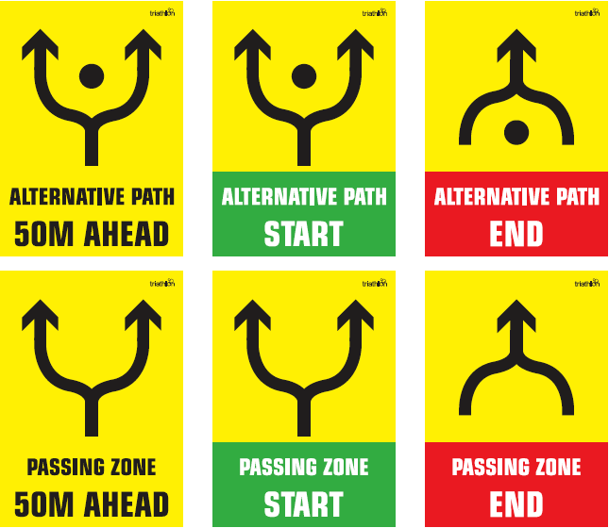
UCI MTB course marking
Insert official World Triathlon event logo,
color version

Slide 30
Caution
Insert official World Triathlon event logo,
color version

Slide 31
Bike to Run
<Insert Bike to Run map through TA2>
Insert official World Triathlon event logo,
color version

Slide 32
Run course
<number of laps> laps (total distance of <total length of the bike in kilometer>km)
Aid stations:
<number> per lap
For locations see the map
Sealed water and ice {if applicable}
Discard plastic bottles and litter within the littering zones indicated by the following signs:
Photo-finish {if applicable}
Congestion in finish area:
Go to mixed zone / recovery area
Insert official World Triathlon event logo,
color version

Slide 33
Run Course Map
Insert Run Course Map (show locations of aid station, lap counter, penalty box & finish chute)
Insert official World Triathlon event logo,
color version

Slide 34
Run Penalty Box – ELITE only
Start infringements will be served in T1 Swim, T1, Bike, T2 and Run Infringements will be served in Run
Transition will be videotaped for infringements {if applicable}
Location: {include the exact location} m before the Transition Area
Information: White board to show race numbers and letters to indicate violations
(Athletes need to read the board – coaches are advised to check and inform their athletes)
Procedure: 10/15 seconds {choose correct} time penalty served on any lap of the run
Penalties must be posted prior to the last lap on the run. Any penalties following that point will be served on the spot.
Athletes have the option to decide whether to stop at the penalty box and serve the penalty or continue to the finish. Not stopping will result in DSQ on crossing the finish line. The athlete may then appeal the penalty. Evidence will only be made available if an appeal is filed.
Insert official World Triathlon event logo,
color version

Slide 35
Run Penalty Box
Rule interpretation
Mount after the mount line: An athlete’s foot must contact the ground past the mount line, before the athlete mounts the bike. If this contact doesn’t occur, it is considered an infringement of the rules (M).
Dismount before the dismount line: An athlete’s foot must contact the ground before the dismount line after the athlete dismounts the bike. If this contact doesn’t occur, it is considered an infringement of the rules (D).
Discharge or store your equipment inside your designated area: Leaving the equipment (swim cap, goggles, helmet, etc.) in the designated box. If leaving the equipment outside the box, it is considered an infringement of the rules (E).
Insert official World Triathlon event logo,
color version

Slide 36
Run Penalty Box
Violations Abbreviations:
For example:
Littering | L |  | Mount Line | M
Swim violations | S |  | Dismount Line | D
Equipment outside the box | E |  | Other violations | V
12 D | athlete #12 received a time penalty for a dismount line violation
12x2 ME | athlete #12 received 2-time penalties for mount line and equipment outside the box violations
Insert official World Triathlon event logo,
color version

Slide 37
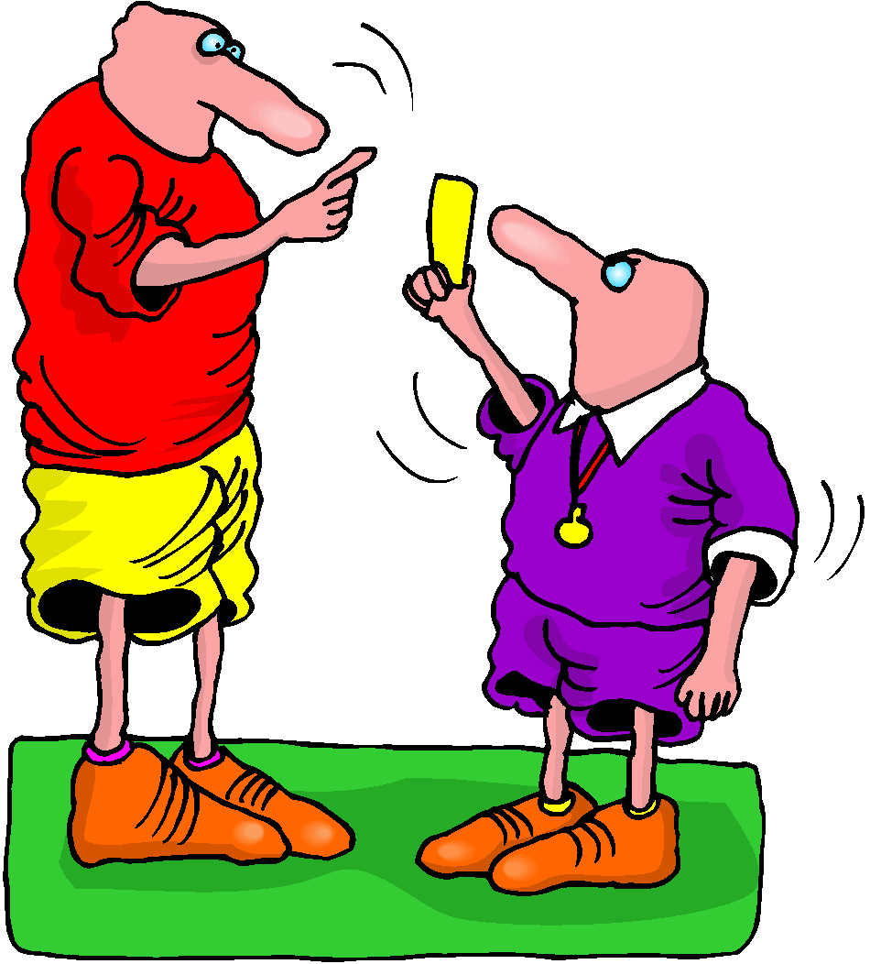
Advice of Penalties - AG
The official will
Sound a whistle or horn
Show a YELLOW card
Call your number
Advise you of the penalty
The time penalty is served on the spot. Follow the instruction of the Technical Officials.
If you are shown a RED card, you are disqualified

Slide 38
Post-race Procedures
When you finish, keep moving through to the mixed-zone and recovery area
For awards, dress “up” with race uniform or country clothes
Awards Ceremony immediately following finish
Ambush marketing rules apply
Insert official World Triathlon event logo,
color version

Slide 39
Ambush Marketing Rules
For ceremony awards, please dress up with race uniform (or country uniform) Ambush marketing rules apply.
Race caps/visors are allowed at the podium
Ambush marketing is defined as:
“Deliberately using the opportunity of live television and media photographers to acquire additional exposure for your sponsor product, apparel or brand.”
Please follow the ambush marketing rule
The consequence for this behavior is: (if applicable)
The athlete will immediately forfeit their prize money for that event.
Insert official World Triathlon event logo,
color version

Slide 40
Post-race Procedures
Anti-Doping Control
Photo ID is needed for every athlete to have ready for Doping Control
Medical
Only one accredited team medical will be allowed to enter the medical tent after the World Triathlon Medical Delegate’s permission. {if no Medical delegate, replace with LOC Medical Doctor}
Insert official World Triathlon event logo,
color version

Slide 41
Medal Ceremony - Elite
{Insert all the important information regarding the medal ceremony for the medalists and the attendances}
As per the World Triathlon Competition rules:
2.8 c.) (i) Athletes must wear the uniform during the entire competition and award ceremony. Long sleeves and long pants are allowed for the award ceremony
Elite athletes are not allowed to carry their country flag on the podium; there will be flags raising with the playing of the national anthem of the winner.

Slide 42
Results and Medal Ceremony - AG
{enter locations that the results will be posted}
{Insert all the important information regarding the medal ceremony for the medalists and the attendances}
As per the World Triathlon Competition rules:
2.8 c.) (i) Athletes must wear the uniform during the entire competition and award ceremony. Long sleeves and long pants are allowed for the award ceremony
Kids are not allowed on the podium.
If you can not attend the medal ceremony, your Team Manager or one of your team mates should pick up your medal at the end of the ceremony.

Slide 43
Coaches Area
Anti-Doping Control
All coaches have to collect accreditation to be able to enter the venue.
Only Coaches who have been registered from their NF into the World Triathlon online system are entitle for an accreditation {if applicable}
Coaches’ areas
Behind / beside / at <location> {describe exactly, choose the correct)
Show map if available
Coaches will have a designated space available on the bike and run segments to supply athletes with their own food and beverages. {comment to be deleted: show on a map}
Insert official World Triathlon event logo,
color version

Slide 44
Important updates
{If applicable}
Insert official World Triathlon event logo,
color version

Slide 45
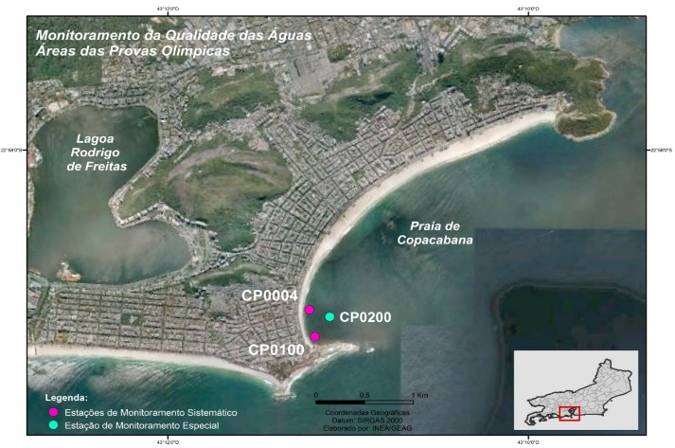
Water Quality Assessment (Sea/Transition)
{select the appropirate}
Update orange text accordingly
Enterococci
Insert Sample Date | NMP/100mL
Location A | 10
Location B | 10
Location C | 10
Enterococci limit | <100
E.Coli
Insert Sample Date | NMP/100mL
Location A | 80
Location B | 80
Location C | 80
E.Coli limit | <250
PH
Insert Sample Date
Location A | 7
Location B | 7
Location C | 7
PH limit | 6-9
Weather forecast
Day | Weather
Briefing (B) | Overcast with light rain
B +1 | Overcast (20% chance of rain
Race Day | Overcast (20% chance of rain
Weather report
Day | Weather
B-3 | Heavy rain in the evening
B-2 | Sunny
B-1 | Sunny
Visual Sanitary Inspection (last 12 hours)
Location | Visual Pollution | Odour | Time of visit | Comments
Location | None | None | 09:15 | Insert comments if necessary
SUMMARY
Add text from competition rules – 10.3.f.i or 10.3.g.i YOU CAN FOUND IT IT THE SLIDE NOTES BELOW, eg. 3 = ‘Fair Water Quality’: (E.Coli: 250 to 500 or Enterococci 100 to 200), but with potential or poor visual pollution during sanitary check and/or potential for forecast of heavy rain;
Insert official World Triathlon event logo,
color version
Notes:
Water Quality Decision Matrix (Sea and Transition water)
1 = ‘Very Good Water Quality’: (E.Coli < 250 or Enterococci < 100) with no or potential visual pollution during sanitary check or forecasted heavy rain;
2 = ‘Good Water Quality’: (E.Coli < 250 or Enterococci < 100) with poor visual pollution during sanitary inspection or forecasted heavy rain;
2 = ‘Good Water Quality’: (E.Coli: 250 to 500 or Enterococci 100 to 200) but with no or potential visual pollution during sanitary inspection or forecasted heavy rain;
3 = ‘Fair Water Quality’: (E.Coli: 250 to 500 or Enterococci 100 to 200), but with potential or poor visual pollution during sanitary check and/or potential for forecast of heavy rain;
4 = ‘Poor Water Quality’: (E.Coli > 500 or Enterococci > 200), with any visual pollution during sanitary check and/or potential for forecast of heavy rain.
Water Quality Decision Matrix (Inland water)
1 = ‘Very Good Water Quality’: (E.Coli < 500 or Enterococci < 200) with no or potential visual pollution during sanitary check or forecasted heavy rain;
2 = ‘Good Water Quality’: (E.Coli < 500 or Enterococci < 200) with poor visual pollution during sanitary inspection or forecasted heavy rain;
2 = ‘Good Water Quality’: (E.Coli: 500 to 1000 or Enterococci 200 to 400) but with no or potential visual pollution during sanitary inspection or forecasted heavy rain;
3 = ‘Fair Water Quality’: (E.Coli: 500 to 1000 or Enterococci 200 to 400), but with potential or poor visual pollution during sanitary check and/or potential for forecast of heavy rain;
4 = ‘Poor Water Quality’: (E.Coli > 1000 or Enterococci > 400), with any visual pollution during sanitary check and/or potential for forecast of heavy rain.

Slide 46
Water Quality Assessment (Inland)
{select the appropirate}
Update orange text accordingly
Enterococci
Insert Sample Date | NMP/100mL
Location A | 10
Location B | 10
Location C | 10
Enterococci limit | <200
E.Coli
Insert Sample Date | NMP/100mL
Location A | 80
Location B | 80
Location C | 80
E.Coli limit | <500
PH
Insert Sample Date
Location A | 7
Location B | 7
Location C | 7
PH limit | 6-9
Weather forecast
Day | Weather
Briefing (B) | Overcast with light rain
B +1 | Overcast (20% chance of rain
Race Day | Overcast (20% chance of rain
Weather report
Day | Weather
B-3 | Heavy rain in the evening
B-2 | Sunny
B-1 | Sunny
Visual Sanitary Inspection (last 12 hours)
Location | Visual Pollution | Odour | Time of visit | Comments
Location | None | None | 09:15 | Insert comments if necessary
SUMMARY
Add text from competition rules – 10.3.f.i or 10.3.g.i YOU CAN FOUND IT IT THE SLIDE NOTES BELOW, eg. 3 = ‘Fair Water Quality’: (E.Coli: 250 to 500 or Enterococci 100 to 200), but with potential or poor visual pollution during sanitary check and/or potential for forecast of heavy rain;
Insert official World Triathlon event logo,
color version
Notes:
Water Quality Decision Matrix (Sea and Transition water)
1 = ‘Very Good Water Quality’: (E.Coli < 250 or Enterococci < 100) with no or potential visual pollution during sanitary check or forecasted heavy rain;
2 = ‘Good Water Quality’: (E.Coli < 250 or Enterococci < 100) with poor visual pollution during sanitary inspection or forecasted heavy rain;
2 = ‘Good Water Quality’: (E.Coli: 250 to 500 or Enterococci 100 to 200) but with no or potential visual pollution during sanitary inspection or forecasted heavy rain;
3 = ‘Fair Water Quality’: (E.Coli: 250 to 500 or Enterococci 100 to 200), but with potential or poor visual pollution during sanitary check and/or potential for forecast of heavy rain;
4 = ‘Poor Water Quality’: (E.Coli > 500 or Enterococci > 200), with any visual pollution during sanitary check and/or potential for forecast of heavy rain.
Water Quality Decision Matrix (Inland water)
1 = ‘Very Good Water Quality’: (E.Coli < 500 or Enterococci < 200) with no or potential visual pollution during sanitary check or forecasted heavy rain;
2 = ‘Good Water Quality’: (E.Coli < 500 or Enterococci < 200) with poor visual pollution during sanitary inspection or forecasted heavy rain;
2 = ‘Good Water Quality’: (E.Coli: 500 to 1000 or Enterococci 200 to 400) but with no or potential visual pollution during sanitary inspection or forecasted heavy rain;
3 = ‘Fair Water Quality’: (E.Coli: 500 to 1000 or Enterococci 200 to 400), but with potential or poor visual pollution during sanitary check and/or potential for forecast of heavy rain;
4 = ‘Poor Water Quality’: (E.Coli > 1000 or Enterococci > 400), with any visual pollution during sanitary check and/or potential for forecast of heavy rain.

Slide 47
Weather forecasts
 | Temperature in °C | Weather
Friday | <insert data> | <insert data>
Saturday | <insert data> | <insert data>
Sunday | <insert data> | <insert data>
Insert official World Triathlon event logo,
color version

Slide 49
Have a good race!

