Slide 1
Branding instructions to complete your briefing
Use ONLY Arial font. No other font should be used. Minimum font size = 20pt
The template has predefined brand colors. Try to use these colors before any others.
Only the official World Triathlon event logo can be placed on this briefing and no others. Please get it from your LOC. The one on the cover should be on the white version on transparent background
Only use the front cover given to you
You can apply different predefined layout for the text slides but the above must be respected
If you need to highlight some information, use the Blue Text 1 from the World Triathlon color palette

Slide 2
Elite Athletes’ briefing
<insert date of briefing>
Insert official World Triathlon event logo, white version
Notes:
A quick guide to introduce you to the various elements that make up the presentation template.
Brand fonts
Arial is our secondary brand font and should be available organisation-wide.
Brand colours
Our colours have been carefully chosen to engage and represent the world of triathlon, appealing to new audiences and resonating with long-time participants. To achieve this, it is important that they are used both carefully and accurately.
The colours have been set up within the theme of this template.
Charts and tables
Using PowerPoint’s default table and chart styles will pull our on-brand colours through automatically.
Colours should be kept flat with no gradients or shadows.
Get started
Click on the drop-down arrow next to the new slide button at the top to reveal the full suite of slides available.

Slide 3
Agenda
Welcome and Introduction
Competition Jury
Schedules and Timetables
Check-in and Procedures
The Course
Post-Race Procedures
Water Quality Test Results
Weather forecast

Slide 4
Welcome and introduction
<Insert name>, <highest ranked World Triathlon/ Continental Executive Board representative>
<Insert name>, World Triathlon Team Leader {if applicable}
<Insert name>, World Triathlon Technical Delegate
<Insert name>, World Triathlon Assistant Technical Delegate {if applicable}
<Insert name>, World Triathlon Medical Delegate {if applicable}
<Insert name>, World Triathlon Head Referee
<Insert name>, LOC Director
{comment – to be deleted: Insert the names of the officials that are attending the briefing and delete the rest}
Insert official World Triathlon event logo,
color version

Slide 5
Competition Jury
<Insert name>, Chair
<Insert name>
<Insert name>
{comment – to be deleted: Insert the names of the Competition Jury Members, add two more member for World Triathlon Series Grand Final elite competitions}
Insert official World Triathlon event logo,
color version

Slide 6
Schedule and Timetables
<DAY/DATE>
hh:mm – hh:mm Race pack pick-up (after athletes’ briefing)
hh:mm – hh:mm Bike course familiarisation
hh:mm – hh:mm Pasta Party {if applicable}
Insert official World Triathlon event logo,
color version

Slide 7
Schedule and Timetables
<DAY/DATE>
hh:mm – hh:mm Athletes’ Lounge check-in
hh:mm – hh:mm Transition Area check-in for Elite Men/Women {select the appropriate}
hh:mm – hh:mm Swim Warm-up for Elite Men/Women {select the appropriate}
hh:mm Athletes’ Introduction
hh:mm Elite Men/Women Start {select the appropriate}
hh:mm – hh:mm Medal ceremony
{comment – to be deleted: Additional information can be added}
Insert official World Triathlon event logo,
color version

Slide 8
Schedule and Timetables
<DAY/DATE> {Saturday if the briefing is on Thursday}
hh:mm – hh:mm Athletes’ Lounge check-in
hh:mm – hh:mm Transition Area check-in for Elite Men/Women {select the appropriate}
hh:mm – hh:mm Warm-up
hh:mm Athletes’ Introduction
hh:mm Elite Men/Women Start {select the appropriate}
hh:mm – hh:mm Medal ceremony
hh:mm – hh:mm Closing banquet {if applicable}
{comment – to be deleted: Additional information can be added such as «buses leave for the closing ceremony from ….. at hh:mm»}
Insert official World Triathlon event logo,
color version
Notes:
{Include info regarding race schedule, race package distribution, check in procedure, start times and ceremonies – if something is not applicable, please delete from the actual presentation}
Repeat for Men/Women

Slide 9
Race Pack Distribution
ALL athletes/support team must provide a picture ID to receive the package.
Your package includes:
- Stickers – Helmet (3x), Bike (1x), Bag (1x) Stickers
- Body decals – both arms and both legs {if applicable}
- Accreditation - gives access to access lounge on race day
Insert official World Triathlon event logo,
color version
Notes:
{Include info regarding race schedule, race package distribution, check in procedure, start times and ceremonies – if something is not applicable, please delete from the actual presentation}
Repeat for Men/Women

Slide 10
Check-in procedures
{if applicable}
Team officials entering the venue
  Using the shuttle service from the ……………
  Schedule
    <pickup location> to <drop off location>: hh:mm, hh:mm, hh:mm,
    <pickup location> to <drop off location>: hh:mm, hh:mm, hh:mm,
Insert official World Triathlon event logo,
color version
Notes:
{if not applicable – please delete this slide}

Slide 11
Check-in procedures
Athletes’ Lounge
Bike check (Frame, saddle position (-5cm ≤ Men & -2 cm ≤ Women) - approved exceptions on World Triathlon website, traditional handlebars only (clips-on to be removed), wheels and spare wheels (non authorized UCI wheels rule)
  Spare wheels to the wheel-stop {or Athletes Lounge – update accordingly}
  Approval for the addition/modification of any equipment to the bike MUST be
  obtained from the Head Referee up to 10 minutes after the end of the athletes’ briefing
  Mechanic service available
Uniform & race gear check (name, country, logos, World Triathlon logo) – photos taken of each uniform. Wearing other uniform during the race = DSQ
Body marking check (both arms, both legs)
Timing chip distribution (2 for the ankles / 1 for the ankle {choose the correct one} / 1 for the bike {if applicable})
Leave your bag in the Athletes’ Lounge they will be taken to the Recovery Area {if applicable}
Insert official World Triathlon event logo,
color version

Slide 12
Map Athletes’ Lounge - Check-in procedures
<Insert athletes’ lounge map, if applicable>
Insert official World Triathlon event logo,
color version

Slide 13
Permitted Equipment – Uniform {Para only}
Bike and Run
Athletes can wear long-sleeve uniform with/without zipper. Zipper can be at the front or at the back. Front zipper can be undone up to the sternum and must be zipped up for the last 200m.
Athletes can wear a long-sleeve shirt under the uniform – it must be worn for the entire event
Athletes will not be able to remove the shirt at any time during the event
Arm covers can be worn and can be removed during the event BUT only in Transition.
Removal elsewhere during the race will lead to DSQ
PTVI 1 athletes must wear black-out glasses on the bike and run segments.
Logos are allowed only on the frame.
Insert official World Triathlon event logo,
color version

Slide 14
Check-in procedures
Transition Area
Helmet check - Don’t leave your helmet fastened in the transition
The athlete who misses to comply with this rule will receive a <xx> seconds time penalty in TA1 {update accordingly depending on format}.
Running Shoes outside the box, helmet on the bike
No clip-on handlebar is allowed on draft-legal event (Elite/U23, Juniors, Youth)
Insert official World Triathlon event logo,
color version

Slide 15
Pre-start Procedures
Athlete Introduction
10 minutes before start - line-up at {insert location}
Jog to the start line once your name is called
Select your position and stay behind the line!
Insert official World Triathlon event logo,
color version

Slide 16
Pre-start Procedures – Line-up map
<Insert line up map, if applicable>
Insert official World Triathlon event logo,
color version

Slide 17
Start Procedures
Athlete in position
The start can be given any time after the TD/ HR {choose the correct} announces
”On your mark”
Electronic horn blast / Air horn blast {choose the correct}
The race starts
Athletes not moving forward at the start will receive a time penalty in TA1.
Insert official World Triathlon event logo,
color version

Slide 18
False-start Procedures
False-start
Several horn blasts
Everyone goes back to her/his original start spot
Valid start with early starters
If a few athletes start before the horn and everyone else starts with the horn, the false starter(s) will receive a 15/10 second {choose the correct} penalty in TA1.
During the time penalty, the athlete(s) may NOT touch any equipment.
Insert official World Triathlon event logo,
color version

Slide 19
The course
Run 1 <number> lap(s) of <length of one lap>m
Bike <number> laps of <length of one lap>km
Run 2 <number> laps of <length of one lap>km

Slide 20
The course
<Insert TV Show Animation/map, if applicable>
Insert official World Triathlon event logo,
color version

Slide 21
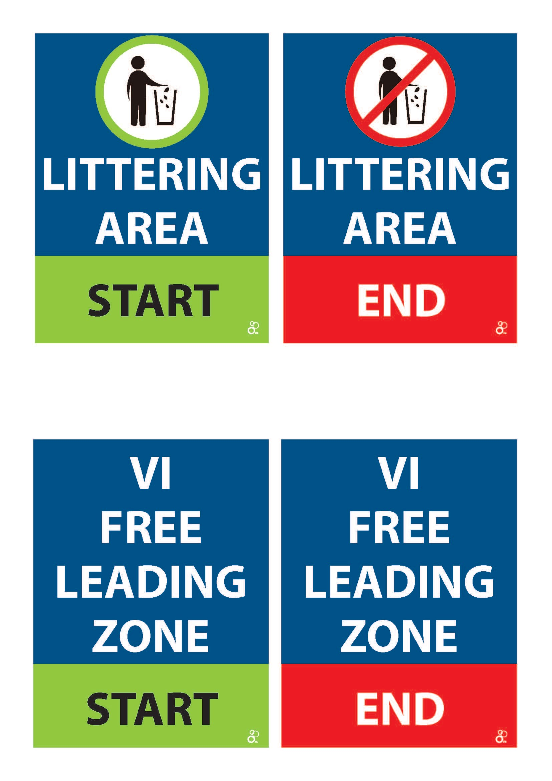
Run course 1
<number of laps> laps (total distance of <total length of the bike in kilometer>km)
Aid stations:
  <number> per lap
  For locations see the map
  Sealed water and ice {if applicable}
  Discard plastic bottles within the littering zones. (20m before and 80m after Aid stations)
Athletes who missed or arrived late at the briefing
(with informing the TD) will receive a Time Penalty during the
1st run in the Penalty Box
Insert official World Triathlon event logo,
color version

Slide 22
Run course 1 map
Insert Run Course Map (show locations of aid station, lap counter) (clarify if the athletes will be passing through the TZ on every lap)
Insert official World Triathlon event logo,
color version

Slide 23
Run behavior
Definition from the World Triathlon CR §6.1:
Where an athlete makes accidental contact during the run with another athlete, then immediately moves away and does not cause a fall the athlete will not incur a penalty.
Where an athlete makes contact with another athlete during the run, continues to impede the progress of the other athlete and does not move away, the athlete will incur a time penalty.
Where an athlete deliberately targets another athlete during the run and impedes their progress, gains an unfair advantage, potentially causes harm or a fall the athlete will be disqualified and may be reported to the World Triathlon Tribunal for potential suspension or expulsion.
Insert official World Triathlon event logo,
color version

Slide 24
Transition Area
Traditional/ Individual Bike Racks – one row / two rows {choose the correct}
Running shoes in front of the box, helmet on the bike – only one pair of shoes can be in front of the box.
Athletes cannot touch the locking mechanism of their helmet from the time they remove their bike from the rack until they have placed it back on the rack and let go after the finish of the bike segment.
Used equipment in the bin. If using one pair of shoes for both run, they can stay outside the box at T1. If using two pairs, the one used for Run 1 must be placed in the box at T1
By the end of the last transition, ALL equipment (used + unused) must be deposited in the corresponding bin.
Bags to the Athletes Lounge
Mount line at the end of the TA (green) / Dismount at entry of the TA (red) {show location}
Insert official World Triathlon event logo,
color version

Slide 25
Post Transition Area {Para only}
A post-transition area after the first transition spot and before the mount line will be provided to drop off prosthetic legs used for athletes who do not wish to hop a long distance in transition. That equipment would move back to the athletes' space in the transition zone by a technical official or an authorized person by the TD to perform this action. That equipment must be clearly identified with the athletes' race number.
Insert official World Triathlon event logo,
color version

Slide 26
Transition Flow
<Insert Run Exit to TZ Map>
{if the flow for Transition 2 is different, place another slide showing the flows before the Run 2 slides}
Insert official World Triathlon event logo,
color version

Slide 27
Bike course
<number of laps> laps (total distance of <total length of the bike in kilometer>km)
Hilly / flat and technical / not technical {choose the correct}
2 Wheel Stations
  1 Neutral wheel station {comment to be deleted: list the type of the provided wheels}
  1 Team wheel station
  For locations see the map
Littering Zones - <locations>
Lap Counter: at the <location of the Lap counter>
Lapped athletes are out of the race
First runner – last biker scenario {if applicable}
Different gender athletes cannot draft each other {if applicable}
Insert official World Triathlon event logo,
color version

Slide 28
Riding position
OK
NOT OK
only ok in draft illegal event

Slide 29
Bike behavior
Definition from the World Triathlon CR §5.1.b:
Where an athlete cuts across or makes accidental contact with another athlete during the bike, then immediately moves away and does not cause a crash the athlete will not incur a penalty.
Where an athlete cuts across another athlete in a dangerous manner or makes contact with another athlete during the bike, does not move away and continues to impede the progress of the other athlete, the athlete will incur a time penalty.
Where an athlete deliberately targets another athlete during the bike and impedes their progress, gains an unfair advantage, potentially causes harm or a crash the athlete will be disqualified and may be reported to the World Triathlon Tribunal for potential suspension or expulsion.
Insert official World Triathlon event logo,
color version

Slide 30
Bike Course Map
<Insert Bike Course Map (show locations of wheel station, lap counter, littering zones and any hazards on the course) (clarify if the athletes will be passing through the TZ on every lap)>
Insert official World Triathlon event logo,
color version

Slide 31
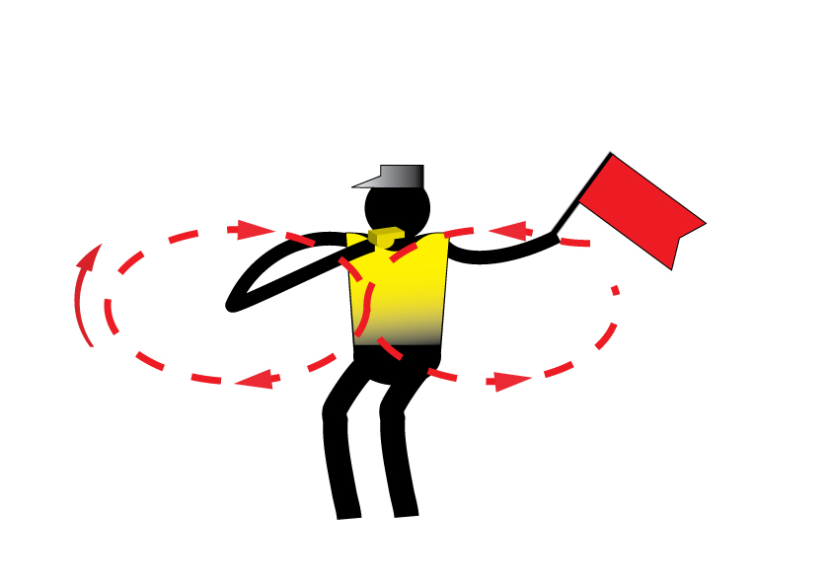
Caution
Insert official World Triathlon event logo,
color version

Slide 32
Run course 2
<number of laps> laps (total distance of <total length of the bike in kilometer>km)
Aid stations:
  <number> per lap
  For locations see the map
  Sealed water and ice sponges {if applicable}
  Discard plastic bottles within the littering zones. (20m before and 80m after Aid stations)
Photo-finish {if applicable}
Congestion in finish area >>> Go to mixed zone / recovery area
Insert official World Triathlon event logo,
color version

Slide 33
Run equipment - shoes
World Triathlon follows World Athletics' Shoe Regulations applicable to road events for all the triathlon and its other related multisports as described in 1.1.a);
Athletes are subject to random shoe control before, during, or after any competition. For any shoe that cannot be identified, each piece of information (and maybe the shoe itself) will be required to be sent to the World Triathlon headquarters for verification within 7 days after the competition it was worn.
In the official results, the athletes under shoe review will have a note (Uncertified/UNC) added to the results footer notes. If the shoe is confirmed as legal, the note will be removed. In any different case, the athlete will be disqualified.
Insert official World Triathlon event logo,
color version

Slide 34
Run Course 2 Map
Insert Run Course Map (show locations of aid station, lap counter & finish chute) (clarify if the athletes will be passing through the TZ on every lap)
Insert official World Triathlon event logo,
color version

Slide 35
Finish
Insert Finish map to show the way into the finish chute {if applicable}
Insert official World Triathlon event logo,
color version

Slide 36
Run Penalty Box
Start infringements will be served in T1
Run1, T1, Bike, T2 and Run2 Infringements will be served in Run
Location: {include the exact location} m before the Transition Area
Information: White board to show race numbers and letters to indicate violations
(Athletes need to read the board – coaches are advised to check and inform their athletes)
Procedure: {include the exact seconds} time penalty served on any lap of the run
Penalties must be posted prior to the last lap on the run. Any penalties following that point will be served on the spot.
Athletes have the option to decide whether to stop at the penalty box and serve the penalty or continue to the finish. Not stopping will result in DSQ on crossing the finish line. The athlete
may then protest the penalty. Evidence will only be made available if an
protest is filed.
Insert official World Triathlon event logo,
color version

Slide 37
Run Penalty Box
Rule interpretation
Mount after the mount line: An athlete’s foot must contact the ground past the mount line, before the athlete mounts the bike. If this contact doesn’t occur, it is considered an infringement of the rules (M).
Dismount before the dismount line: An athlete’s foot must contact the ground before the dismount line after the athlete dismounts the bike. If this contact doesn’t occur, it is considered an infringement of the rules (D).
Discharge or store your equipment inside your designated area: Leaving the equipment (swim cap, goggles, helmet, etc.) in the designated box. If leaving the equipment outside the box, it is considered an infringement of the rules (E).
Insert official World Triathlon event logo,
color version

Slide 38
Run Penalty Box
If you incur a penalty, you will find your number plus a letter code indicating the nature of the infraction:
Violations Abbreviations:
For example:
Dismount Line | D |  | Littering | L
Mount Line | M |  | Equipment outside the box | E
Swim Behavior | S |  | Bike Behavior | B
Run Behavior | R |  | Other violations | V
12 D | athlete #12 received a time penalty for a dismount line violation
12x2 ME | athlete #12 received 2-time penalties for mount line and equipment outside the box violations
Insert official World Triathlon event logo,
color version

Slide 39
Right to protest
An Athlete who receives a penalty may protest, with the exception of:
  (i) a penalty for a drafting violation; and
  (ii) a time penalty which has already been served.
If an athlete serves a time penalty, the athlete accepts the penalty, and no protest will be admitted.
If an athlete does not serve a time penalty, he/she will be disqualified but may protest against the disqualification and the decision of the Head Referee to issue the time penalty.

Slide 40
Post-race Procedures
“Mixed Zone” - immediately after finish 1, 2, 3 with host broadcaster first.
Medal Presentation – protocol – at <hh.mm>
Elite/U23/Junior athletes are not allowed to carry their country flag on the podium; there will be flags raising with the playing of the national anthem of the winner.
Prize money {insert procedure}
Insert official World Triathlon event logo,
color version

Slide 41
Post-race Procedures
Anti-Doping Control
  Photo ID is needed for every athlete to have ready for Doping Control
Medical
  Only accredited team medical will be allowed to enter the medical tent after the LOC Doctor’s permission.
Insert official World Triathlon event logo,
color version

Slide 42
Medal Ceremonies
As per the World Triathlon Competition rules:
2.8 c.) (i) Athletes must wear the uniform during the entire competition and award ceremony. Long sleeves and long pants are allowed for the award ceremony
Elite/U23/Junior athletes are not allowed to carry their country flag on the podium; there will be flags raising with the playing of the national anthem of the winner.
Insert official World Triathlon event logo,
color version

Slide 43
Ambush Marketing Rules
For ceremony awards, please dress up with race uniform (or country uniform)
Ambush marketing rules apply.
Race caps/visors are allowed at the podium
Please follow the Ambush marketing rules. Ambush marketing is defined as:
“Deliberately using the opportunity of live television and media photographers to acquire additional exposure for your sponsor product, apparel or brand.”
The consequence for this behavior is: The athlete will immediately forfeit their prize money for that event. (if applicable)
Insert official World Triathlon event logo,
color version

Slide 44
Coaches Accreditation / Coaches Areas
Accreditation
  All coaches have to collect accreditation to be able to enter the venue – a picture ID needed.
  Only Coaches/Support Crew who have been registered from their NF into the World Triathlon online system are entitled for an accreditation
  Support to the athletes is composed by the following categories: Coaches, Medical, Bike Mechanic, Ski man and NF representatives. World Triathlon may add other categories if needed in a specific event. The people entered in the categories of Coaches and Medical must complete the Anti-Doping Education course.
Coaches’ areas
  Behind / beside / at <location> {describe exactly, choose the correct)
  Show map if available
Insert official World Triathlon event logo,
color version

Slide 45
Outside assistance {Para only}
Assistance can be provided to a Para triathlete to allow them to get back into their handcycle/racing wheelchair or onto their bike following an incident. Any mechanical repair must be done by the athlete without external assistance. Assistance may only be provided by a Technical Official, Event Personnel, or another athlete in the same race.
Insert official World Triathlon event logo,
color version

Slide 46
Important updates
{If applicable}, else delete the slide
Insert official World Triathlon event logo,
color version

Slide 47





Heat stress indicators
Warning flags will be placed at the athletes’ area and behind the spectators’ stands

Slide 48
Weather forecasts
 | Temperature in °C | Weather
Friday | <insert data> | <insert data>
Saturday | <insert data> | <insert data>
Sunday | <insert data> | <insert data>
Insert official World Triathlon event logo,
color version

Slide 49


Slide 50
Have a good race!

