Slide 1
BUENOS AIRES 2018 YOUTH OLYMPIC GAMES
TRIATHLON COMPETITION
Team Manager Briefing
Mixed Relay Competition
9 October 2018
18:00h

Slide 2
Agenda
Welcome and Introduction
Competition Jury
Schedules and Timetables
Check-in and Procedures
The course
Post-Race Procedures
Weather forecast

Slide 3
Welcome and introduction
Gergely Markus – ITU Sport Director
Thanos Nikopoulos– ITU Head of Operations
Miguel Fernández– ITU Event Delegate
Bex Stubbings– ITU Head Referee
Dr. Gerardo Aguilar– ITU Medical Delegate
Gustavo Svane– Triathlon Event Manager

Slide 4
Competition Jury
Miguel Fernández– Chair
Gergely Markus – International Triathlon Union
Orlando Arauz – Argentina National Federation

Slide 5
Schedule and Timetables
Tuesday, October 9th
Race package distribution
Immediately after the briefing
Race package includes:
1 x Bike number per athlete
3 x Helmet stickers per athlete
4 x sets of body decals per athlete
water bottles – provided at venue if needed
One of the four team managers should be appointed as Team representative

Slide 6
Schedule and Timetables
Thursday, October 11th Mixed Relay Competition
08:00 – 08:15 Modification of the Mixed relay team start order Meet the Head Referee at the Athletes’ lounge
09:00 - 10:30 Athletes Lounge Check In
09:30 - 10:30 Transition Zone Check In
09:30 - 10:15 Cycle/Run Course Warm Up
09:30 - 10:30 Swim Course Warm Up
10:45 Athletes’ assembly at the Athletes’ lounge
10:50 Athletes’ Introduction
11:00 Youth Mixed Relay Race Starts
12:50 Medal Ceremony

Slide 7
Schedule and Timetables
Thursday, October 11th Focus Day
13:00 – 13:45 Lunch
13:45 – 14:00 Focus day teams’ meeting
Meet your team members at the athletes’ area
14:00 – 14:15 Transition check in
14:15 Race briefing (in transition zone)
14:20 Team introduction
14:30 Focus day race start

Slide 8
Check-in Procedures
Bike Check
Bike Check: handlebars, frames, logos, wheels – carried out prior to competition day. Random check on race day
Water bottles (can use own if unbranded otherwise use bottles provided by BAYOGOC)
Helmet - logos
Spare wheels will be checked and labelled at athletes´ lounge. Wheels will be transferred by the LOC to the wheel station and collect them after the race at athletes´ lounge.
Disc brakes are now legal and spare wheels with disc brakes may be placed at the team wheel station however they are not allowed in the neutral wheel station
Approval for the addition/modification of any equipment to the bike, MUST be obtained from the Head Referee up until 10 minutes from the end of this Athlete’s Briefing
Mechanic service available

Slide 9
Check-in Procedures
Athletes’ Lounge
ALL Team Members must check in together!
Uniform and wetsuit check (Rule 50 and ITU Regulations)
Photos taken of each uniform. Wearing other uniform during the race = DSQ!
Body marking check (both arm & legs)
Timing chip & Swim cap distribution for 1st athlete
2nd, 3rd and 4th team member will collect the timing chip & swim cap from the relay area
Athletes MUST be in the relay check in zone in time to collect chip and be ready
Store gear at the athletes’ lounge and leave your accreditation there

Slide 10
Check-in Procedures
Transition check in
ALL team members check in together
Last athlete nearest the mount line.
Helmet – Do not leave helmet straps fastened in transition
Running shoes go outside and in front of your box
Your box may be on either side of your bike rack
The bike must be racked in the first transition by the rear wheel and in the second transition by either wheel

Slide 11
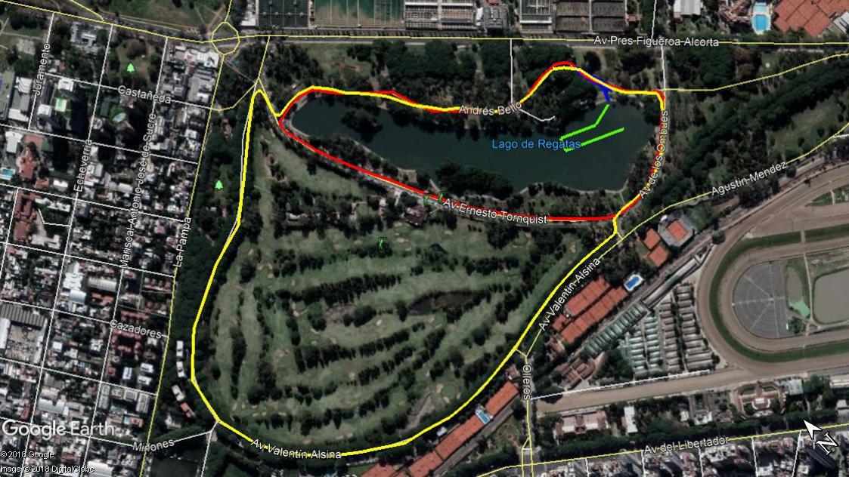
Warm-up
Swim Warm Up
Run Warm Up
BikeWarm Up

Slide 12
Pre-Start Procedure
Athletes Introduction
15 minutes before your start, line up together in athletes’ area
When you are introduced, jog together towards the swim start.
First athlete.
Jog to pontoon (your pontoon position is your race number +17, e.x. team 3: start position 20) and stay behind line.
2nd ,3rd and 4th: Stop at relay zone

Slide 13
Start Procedure
Athletes in position:
The start can be given any time after the Head Referee announces ”On your marks”
Electronic horn blast
Race starts
Athletes not moving forward at the start will receive a time penalty of 10 seconds in TA1

Slide 14
False Start Procedure
False start with many athletes:
Several horn blasts
Kayaks in front of you
Everyone goes back to his or her original start spot
Valid start but with early starters:
If someone starts before the horn and every one else starts with the horn, the false starter will receive a time penalty of 10 seconds in TA1
During the time penalty the athlete cannot touch any race equipment

Slide 15
The Course
Swim
1 lap of 300m
Bike
2 laps of 3,2km
Run
1 lap of 2km

Slide 16
The Course

Slide 17
Swim Course
Today at 11:00
Water temperature: 20,8°C
Final decision 1 hour before race start
1 lap (total distance of 300m) –clockwise
Distance to the first turn buoy 140m
Pass all yellow buoys on the right shoulder/ Pass all the red buoys on the left
Swim behaviour will be closely monitored and recorded
Take wetsuit, cap, goggles to transition into the box

Slide 18
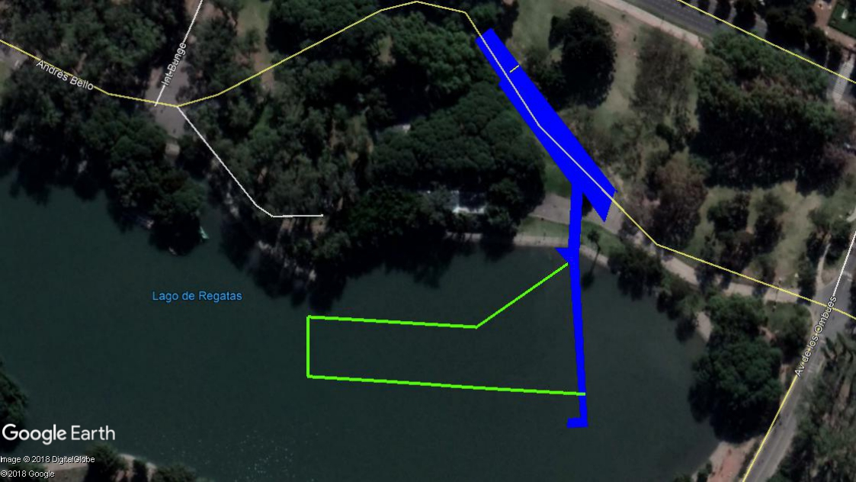
Swim Course Map
TRANSITION AREA
START

Slide 19
Swim exit to transition
FINISH CHUTE
BIKE LANE
TRANSITION ZONE
RELAY ZONE
RELAY ZONE
RECOVERY
RELAY ZONE
CHECK IN

Slide 20
Transition Area
Individual bike racks
Team name, team member’s country flag and number
All used equipment goes into YOUR box
Failure to put equipment in box = 10 second penalty on run PB
Mount line at the end of the TA (GREEN LINE)
Dismount line at the beginning of TA (RED LINE)

Slide 21
Bike Course
Number of laps: 2
Flat, no technical
2 Wheel Stations
Team wheels at first station (marked wheels to be delivered to athletes lounge and be transferred by the LOC)
Neutral wheels at other station
For locations see the map
1 Littering zones for bike (Aid station 1)
Lapped athletes will not be removed from the course. They should not draft with lead athletes/ groups

Slide 22
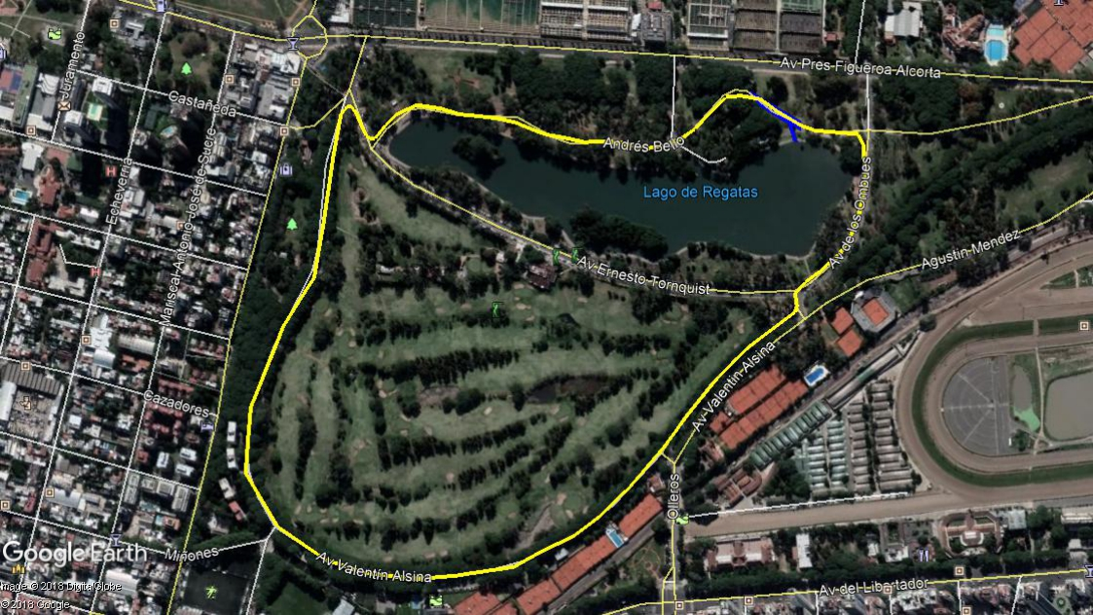
Bike Course Map
TEAM WHEEL STATION
TRANSITION ZONE
NEUTRAL WHEEL STATION

Slide 23
Bike lap
FINISH CHUTE
BIKE LANE
TRANSITION ZONE
RELAY ZONE

Slide 24
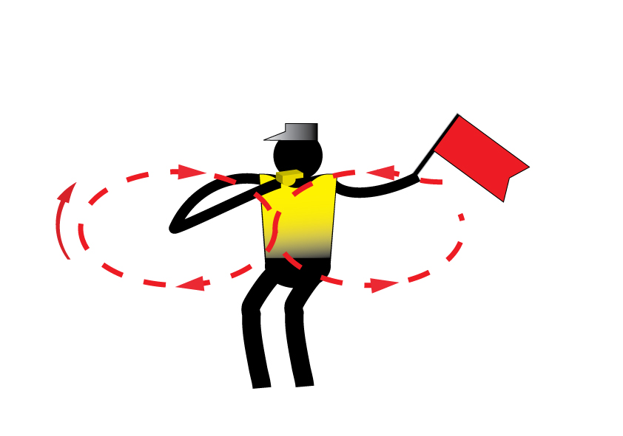
Caution
Caution signal: three sharp whistles and red flags

Slide 25
Neutral Wheel station
Front Shimano 700c
Rear Shimano 700C 11 Cassette 14/28

Slide 26
Bike to transition 2
FINISH CHUTE
BIKE LANE
TRANSITION ZONE
RELAY ZONE

Slide 27
Run Course
Number of laps: 1 (it is separated with cones from the bike course)
1st, 2nd and 3rd athlete will run 1952m/ 4th athlete – 2027m
Aid stations:
2 per lap
For locations see the map
Sealed water
Discard plastic bottles off course
4th athlete will have to cross the bike path to access the finish. Any remaining cyclists will be stopped. Runners have priority.
Photo-finish at the finish area
Congestion in relay zone/ finish area:
Go to recovery area (relay zone & finish/ mixed zone)

Slide 28
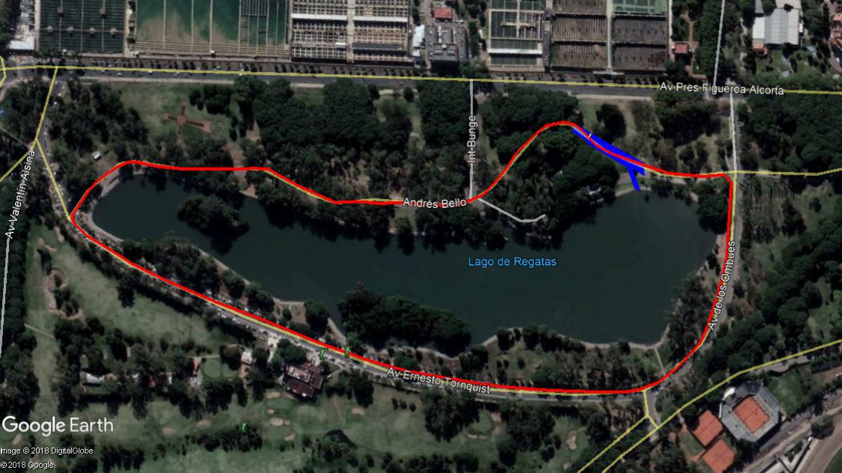
Run Course Map
FINISH LINE
TRANSITION ZONE
AID STATION 1
PENALTY BOX
RELAY ZONE
AID STATION 2

Slide 29
Run penalty box
The penalty box is for infringements in: swim,TA1, bike, TA2 and run
e..x.: Swim conduct, mount before mount line, dismount after dismount line, discharge or store your equipment outside your box, rack the bike outside your own space, etc
(Transition will be videotaped for infringements)
Location: Before the end of each lap (see the map)
Information: White board to show race numbers and violation
(Athletes need to read the board)
Procedure: 10 second time penalty served on any lap of the run
ANY member of the team can serve the penalty
If you don’t stop DSQ

Slide 30
Run penalty box
If you incur a penalty, you will find your number plus a letter code indicating the nature of the infraction:
D = Dismount Line Violation S = Swim Conduct
M = Mount Line violation E = Equipment Outside Box
L = Littering V = Other Violations
For example:
12D….athlete #12 received a time penalty for a dismount line violation
2x12ME…athlete #12 received 2 time penalties for mount line and equipment outside the box violations

Slide 31
Relay Zone
Prior to the relay exchange, the athletes will wait in the relay zone check in area until the moment when the Technical official tells them to enter the relay zone.
It is athletes’ responsibility to be there, collect timing chip and be ready
The relay exchange from one team member to another will take place inside the „Relay Zone”

Slide 32
Relay Zone
The relay exchange is completed by the incoming athlete, using their hand to contact the body of the out-going athlete within the relay zone
If the contact occurs outside the relay zone, both athletes must return to the relay zone and complete the exchange properly.
Keep both Feet behind the relay line
If the exchange is not completed inside the relay zone, the team will get a 10 second penalty

Slide 33
Relay zone
FINISH CHUTE
BIKE LANE
TRANSITION ZONE
RELAY ZONE

Slide 34
Post Race Procedure
All Team members of the first 3 teams are requested to wait in the Finish Area
Athletes in poor condition to the Medical Area
“Mixed Zone” - immediately after finish

Slide 35
Medal Ceremony
Medalists will be escorted by Technical Officials.
Ceremony will take place immediately following the race.
Athletes are required to wear their NOC uniform – no country flags to the podium

Slide 36
Coaches Area
Athletes’ lounge
Next to the swim course
Next to the transition zone/ relay zone
Next to the run penalty box
Recovery area

Slide 37
Focus Day
Relay with one athlete per segment
Random composition of the teams named after
Olympic cities,
Youth Olympic cities and
Former Youth Olympic Champions
Teams:
1 YOG Men, 1 YOG Women, 1 Local Argentinian Athlete
ITU President and Athlete Role Models are also participating
Technical Official / ITU Staff

Slide 38
Focus Day – Teams (find your teammate!)
Team Athens 1896 | Agustin Ortiz, ITU | Olalla Cernuda, ITU | Antonio Fernandez Arimany, ITU
Team Paris 1900 | Baptiste Passemard, FRA | Syrine Fattoum, TUN | Angel Tomas Benitez, ARG
Team St. Louis 1904 | Xian Hao Chong, MAS | Maryhelen Albright, USA | Maximiliano Botelli, ARG
Team London 1908 | Mohamed Aziz Sebai, TUN | Brea Roderick, NZL | Pedro Emmert, ARG
Team Stockholm 1912 | Andreas Carlsson, SWE | Ho Yan Lo, HKG | Juan Girard, ARG
Team Antwerp 1920 | Rik Malcorps, BEL | Karina Clemant, VEN | Santiago Riboli Lanteri, ARG
Team Paris 1924 | Maria Chara, ITU | Abayuba Rodriguez, ITU | Siim Vollmer, ITU
Team Amsterdam 1928 | Mohamed Tarek, EGY | Inês Rico, POR | Mauro Gonzalez, ARG
Team Los Angeles 1932 | Andrew Shellenberger, USA | Sif Bendix Madsen, DEN | Emiliano Marti, ARG
Team Berlin 1936 | Dominic Pugliese, ISV | Marie Horn, GER | Julio Facundo Pavoni, ARG

Slide 39
Focus Day – Teams (find your teammate!)
Team London 1948 | Sebastian Cordero, ITU | Andrea Huarte, ITU | Gerardo Aguilar, ITU
Team Helsinki 1952 | Zakaria Alkarrat, SYR | Sofia Rodriguez Moreno, MEX | Nicolas Svane, ARG
Team Melbourne 1956 | Cristobal Baeza Muñoz, CHI | Chiara Lobba, ITA | Federico Ruiz, ARG
Team Rome 1960 | Alessio Crociani, ITA | Paula Vega, ECU | Fausto Miguel Sevillano, ARG
Team Tokyo 1964 | Teppei Tokuyama, JPN | Eva Daniels, LUX | Francisco Sole, ARG
Team Mexico City 1968 | Javier Antonio De La Peña Schott, MEX | Barbara De Koning, NED | Facundo Ubeda, ARG
Team Munich 1972 | Henry Graf, GER | Maria Fernanda Barbosa Sanchez, COL | Francisco Vittase, ARG
Team Montreal 1976 | Solen Wood, CAN | Nikolett Ferenczi, HUN | Julian Zampedro, ARG
Team Moscow 1980 | Giannon Lisandro Eights, ARU | Alevtina Stetsenko, RUS | Fabian Fernandez, ARG
Team Los Angeles 1984 | Irving Zabala, ITU | Victor Figueredo, ITU | Jeff Lim, ITU

Slide 40
Focus Day – Teams (find your teammate!)
Team Seoul 1988 | Dylan Mccullough, NZL | Jung Won Lee, KOR | Belen Alcaron, ARG
Team Barcelona 1992 | Igor Bellido Mikhailova, ESP | Niuska Figueredo Bringa, CUB | Sofia Aguilera, ARG
Team Atlanta 1996 | Alexandre Montez, POR | Giovanna Lacerda, BRA | Nicolas Serer, ARG
Team Sydney 2000 | Joshua Ferris, AUS | Enya Noël, GRN | Andreina Confalonieri, ARG
Team Athens 2004 | Thanos Nikopoulos, ITU | Miguel Fernandez, ITU | Gergely Markus, ITU
Team Beijing 2008 | Daniil Zubtsov, KAZ | Xinying Yu, CHN | Estefania Diaz, ARG
Team London 2012 | Cristian Andres Triana Peña, COL | Libby Coleman, GBR | Rocio Dry, ARG
Team Rio de Janeiro 2016 | Marisol Casado, ITU | Barbara Riveros, ITU | Ron Darmon, ITU
Team Tokyo 2020 | Pedro Henrique Boff, BRA | Hanne Peeters, BEL | Nazarena Salinas, ARG
Team Paris 2024 | Christiaan Stroebel, RSA | Emilie Noyer, FRA | Cristian Hidirate, ARG

Slide 41
Focus Day – Teams (find your teammate!)
Team Los Angeles 2028 | Alejandro Rodriguez Diez, CUB | Anja Weber, SUI | Rayen Asselborn, ARG
Team Singapore 2010 | Gergely Kiss, HUN | Emma Ada Middleditch, SGP | Ambar Pais, ARG
Team Nanjing 2014 | Lee Mo, ITU | Natasa Preis - Bedenik, ITU | Clare Davey, ITU
Team Buenos Aires 2018 | Tik Long Hung, HKG | Delfina Orlandini, ARG | Andres Sanucci, ARG
Team Senegal 2022 | Gabriel Terán Carvajal, ECU | Maram Elshafei, EGY | Martina Juri, ARG
Team Yuka Sato | Itamar Shevach Levanon, ISR | Maki Uchida, JPN | Aixa Segovia, ARG
Team Daniel Hoy | Loïc Triponez, SUI | Naomi Espinoza Guablocho, PER | Ana Paula Cabral, ARG
Team Britany Dutton | Jan Škrjanc, SLO | Charlotte Derbyshire, AUS | Lourdes Aguirre, ARG
Team Ben Dijkstra | Calum Young, GBR | Amber Schlebusch, RSA | Sol Asconape, ARG

Slide 42
Focus Day
Course: 300m swim (1 lap) – 3.2km bike (1 lap) – 2km run (1 lap)
Relay change at the transition zone next to each teams bike rack
All athletes should be waiting at the transition waiting area

Slide 43
Relay zone
FINISH CHUTE
TZ WAITING AREA
TRANSITION ZONE

Slide 44
Focus Day
Not competition, but FUN!
After the finish,
all teams must go to the finish board with the Olympic Motto ” Citius, Altius, Fortius”,
They will be asked to write a word representing the Games atmosphere starting from one letter of the Olympic Motto and sign. E.x. “F”: Fun

Slide 45
Weather Forecast
Temp Weather
Thursday 16ºC

Slide 46
Access to Briefing Information
http://www.triathlon.org/about/downloads/category/race_briefings/

Slide 47
GOOD LUCK!

