Slide 1
Athlete’s briefing
<Insert Event Logo>
<Insert Date>

Slide 2
Briefing agenda
Welcome and Introductions
Competition Jury
Schedules and Timetables
Check-in and Procedures
The course
Post-Race Procedures
Water Quality Test Results
Weather forecast
<Insert Event Logo>

Slide 3
Welcome and Introductions
<Insert name>, <highest ranked ITU/ Continental Executive Board representative>
<Insert name>, ITU Team Leader {if applicable}
<Insert name>, ITU Technical Delegate
<Insert name>, ITU Head Referee
<Insert name>, LOC Director
{comment – to be deleted: Insert the names of the officials that are attending the briefing and delete the rest}
<Insert Event Logo>

Slide 4
Competition Jury
<Insert name>, Chair
<Insert name>
<Insert name>
{comment – to be deleted: Insert the names of the Competition Jury Members, add two more member for World Triathlon Series Grand Final elite competitions}
<Insert Event Logo>

Slide 5
Schedule and Timelines
Friday {Thursday if the briefing is on Thursday}
hh:mm – hh:mm Race pack pick-up (after the athletes’ briefing)
Your Package includes:
{Write what is included in the race package}
hh:mm – hh:mm Pasta Party {if applicable}
Saturday {Friday if the briefing is on Thursday}
hh:mm – hh:mm Training Sessions in the swimming pool
{if applicable}
hh:mm – hh:mm Bike course familiarization {if applicable}
( Meeting Point: ……….)
hh:mm – hh:mm Swim course familiarization {if applicable}
<Insert Event Logo>

Slide 6
Schedule and Timelines
Sunday {Saturday if the briefing is on Thursday}
hh:mm – hh:mm Athletes’ Lounge open and check-in
hh:mm – hh:mm Transition Area open for Elite Women
hh:mm – hh:mm Swim Warm-up for Elite Women
Hh:mm Athletes’ Introduction
hh:mm Elite Women Start
hh:mm – hh:mm Medal ceremony
{comment – to be deleted: Additional information can be added}
<Insert Event Logo>

Slide 7
Schedule and Timelines
Sunday {Saturday if the briefing is on Thursday}
hh:mm – hh:mm Athletes’ Lounge open and check-in
hh:mm – hh:mm Transition Area open for Elite Men
hh:mm – hh:mm Swim Warm-up for Elite Men
Hh:mm Athletes’ Introduction
hh:mm Elite Men Start
hh:mm – hh:mm Medal ceremony
hh:mm Closing ceremony
{comment – to be deleted: Additional information can be added, such as „ buses leave for the Closing Ceremony from………. at hh:mm”}
<Insert Event Logo>

Slide 8
Check-in and procedures
{if applicable}
Team officials entering the venue
Using the shuttle service from the ……………
Schedule
(<pickup location> to <dropoff location>):
hh:mm, hh:mm, hh:mm,
(<pickup location> to <dropoff location>):
hh:mm, hh:mm, hh:mm,
<Insert Event Logo>

Slide 9
Check-in procedures
Athletes Lounge (Bike check)
Refer to 5.2 in competition rules
Handle bars with clips-on
Wheels and spare wheels (non authorized UCI wheels rule)
Disc brakes are now legal and spare wheels with disc brakes may be placed at the team wheel station however they are not allowed in the neutral wheel station
Leave your spare wheels to the Bike Check {if applicable}
Bike frame
<Insert Event Logo>

Slide 10
Check-in procedures
Athletes Lounge (Bike check)
Saddle position ( -5 cm ≤ Men & -2 cm ≤ Women)
Approved exceptions on ITU website
Approval for the addition/modification of any equipment to the bike, MUST be obtained from the Head Referee at the end of the athletes’ briefing
Mechanic service available
<Insert Event Logo>

Slide 11
Map Athletes’ Lounge
<Insert athletes’ lounge map, if applicable>

Slide 12
Check-in procedures
Athletes Lounge
Uniform & race gear check (name, country, logos, ITU logo) – photos taken of each uniform. Wearing other uniform during the race = DQF!
Swim skins have to be under the guidelines of the wetsuit and must be worn throughout the race.
Body marking check (both arms, both legs)
Timing chip distribution (1 for the ankle/ 2 for each ankle choose the correct)
Swim cap distribution
If an athlete wishes to wear a second swim cap, the cap should be unbranded.
Leave your bag in the Athletes’ Lounge they will be taken to the Recovery Area {if applicable}
<Insert Event Logo>

Slide 13
Check-in procedures –(for one TA)
Transition Area
Helmet check- Don’t leave your helmet fastened in the transition
The athlete who misses to comply with this rule will receive a time penalty in TA1.
Running Shoes outside the box, helmet on the bike
To add any equipment to the bike, you must obtain approval from the Head Referee up until 10 minutes after the end of the Athletes‘ Briefing.
<Insert Event Logo>

Slide 14
Check-in procedures- (for two TA)
Transition Area 1 (close to swim start)
Helmet check- Don’t leave your helmet fastened in the transition
The athlete who misses to comply with this rule will receive a time penalty in TA1.
Helmet on the bike
Transition Area 2 (Next to finish shute)
Running Shoes outside the box
In an individual bike rack, the bike must be racked in the first transition by the rear wheel and in the second transition by either of the wheels.
<Insert Event Logo>

Slide 15
Pre-start Procedure
Athlete Introduction:
10 minutes before start - line-up {insert location}
Jog to the platform
Select your position and stay behind the line!
Athlete’s are required to wear the official swim cap from the moment of the athletes’ line-up
<Insert Event Logo>

Slide 16
Line up Map
<Insert line up map, if applicable>
<Insert Event Logo>

Slide 17
Start Procedure
Athletes in position:
The start can be given any time after the TD/ HR {choose the correct} announces ”On your mark”
Electronic horn blast / Air horn blast {choose the correct}
The race starts
Athletes not moving forward at the start will receive a time penalty in TA1.
<Insert Event Logo>

Slide 18
False Start Procedures
False start with many athletes:
Several horn blasts
Kayaks move in front of you
Everyone goes back to her/his original start spot
Valid start with early starters:
If a few athletes start before the horn and everyone else starts with the horn, the false starter(s) will receive a 15/10 second {choose the correct} penalty in TA1.
During the time penalty, the athlete(s) may NOT touch any equipment.
<Insert Event Logo>

Slide 19
Swim Conduct
Definition from the ITU CR §4.1:
e.) Athletes may sportingly maintain their own space in the water:
(i) Where athletes make accidental contact in the swim and then immediately afterwards move apart no penalty will be incurred;
(ii) Where athletes make contact in the swim, and an athlete continues to impede the progress of the other athlete without moving apart, this action will result in a time penalty;
(iii) Where athletes deliberately target another athlete to impede their progress, gain unfair advantage and potentially cause harm will result in disqualification and may be reported to ITU Arbitration Tribunal for potential suspension or expulsion.
<Insert Event Logo>

Slide 20
Swim Conduct
Definition from the ITU CR §4.1:
There will be additional boats and Technical officials deployed on the swim course to monitor athlete’s behaviour in this respect .
Infringements may be recorded and appropriate action will be taken dependant on the rules definition from the previous slide .
Please respect your fellow competitors and keep the race fair.
<Insert Event Logo>

Slide 21
The Course
Swim
<number> lap(s) of <lenght of one lap>m
Bike
<number> laps of <lenght of one lap>km
Run
<number> laps of <lenght of one lap>km
<Insert Event Logo>

Slide 22
The Course
<Insert TV Show Animation, if applicable>
<Insert Event Logo>

Slide 23
Swim course
On {date} at {hh:mm}:
<water temperature> °C
<air temperature> °C
Wetsuit allowed / Wetsuit not allowed {choose the correct}
<number of laps> laps (total distance of <total lenght of the swim in meter>m)
Distance to the first turn buoy <lenght in meter>m
Take cap, goggles to transition into your box
<Insert Event Logo>

Slide 24
Swim course Map
<Insert Swim Course Map>
<Insert Event Logo>

Slide 25
Swim Exit to TA
<Insert Swim Exit to TA Map>
<Insert Event Logo>

Slide 26
Transition Area {first choice}
Swim Exit to TA <meters> m
Traditional Bike Racks – one row / two rows {choose the correct}
All used equipment into the box
Mount line at the end of the TA
<Insert Event Logo>

Slide 27
Transition Area {second choice}
Individual Bike Racks – number, name and country flag
Used equipment into the box
In an individual bike rack, the bike must be racked in the first transition by the rear wheel and in the second transition by either of the wheels
Mount line at the end of the TA
<Insert Event Logo>

Slide 28
Transition Flow
<Insert Swim Exit to TZ Map, show where #1 is on the map for TA1 and TA2>
<Insert Event Logo>

Slide 29
Bike course
<number of laps> laps (total distance of <total lenght of the bike in kilometer>km)
Hilly / flat and technical / not technical {choose the correct}
2 Wheel Stations
1 Neutral wheel station {comment to be deleted: list the type of the provided wheels}
1 Team wheel station
For locations see the map
Lap Counter: at the <location of the Lap counter>
Littering Zones- locations
Lapped athletes are out of the race
First runner – last biker scenario {if applicable}
<Insert Event Logo>

Slide 30
Bike Course Map
<Insert Bike Course Map (show locations of wheel station, lap counter, littering zones and any hazards on the course) (clarify if the athletes will be passing through the TZ on every lap)>
<Insert Event Logo>

Slide 31
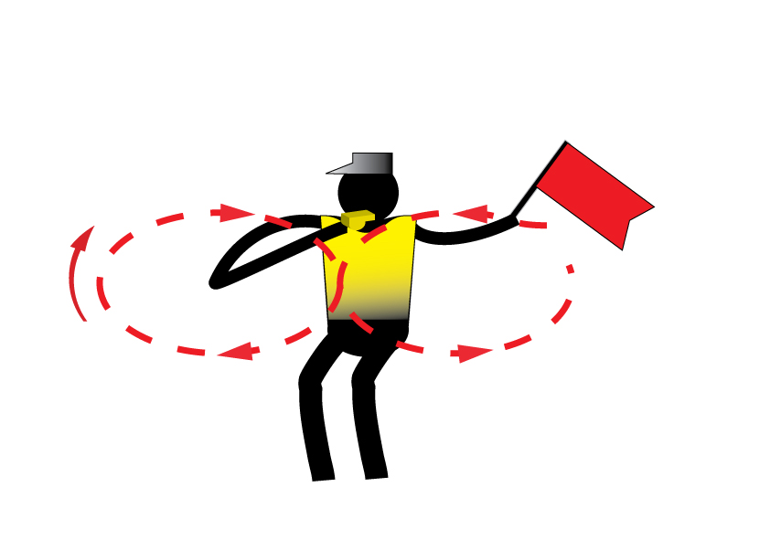
Caution
Caution signal: three sharp whistles and red flags
<Insert Event Logo>

Slide 32
Bike to Run
<Insert Bike to Run map through TA2>
<Insert Event Logo>

Slide 33
Run course
<number of laps> laps (total distance of <total lenght of the bike in kilometer>km)
Aid stations:
<number> per lap
For locations see the map
Sealed water and ice sponges {if applicable}
Discard plastic bottles within the littering zones. (20m before and 80m after Aid stations)
Photo-finish {if applicable}
Congestion in finish area:
Go to mixed zone / recovery area
<Insert Event Logo>

Slide 34
Run Course Map
Insert Run Course Map (show locations of aid station, lap counter, penalty box & finish chute)
<Insert Event Logo>

Slide 35
Run Lap
Insert Run Course Map (clarify if the athletes will be passing through the TZ on every lap)
<Insert Event Logo>

Slide 36
Finish
Insert Finish map to show the way into the finish chute
<Insert Event Logo>

Slide 37
Run Penalty Box
Start infringements will be served in T1
Swim, T1, Bike, T2 and Run Infringements will be served in Run
Location: {include the exact location} m before the Transition Area
Information: White board to show race numbers and letters to indicate violations
(Athletes need to read the board – coaches are advised to check and inform their athletes)
Procedure: {include the exact seconds} time penalty served on any lap of the run
Penalties must be posted prior to the last lap on the run. Any penalties following that point will be served on the spot.
Athletes have the option to decide whether to stop at the penalty box and serve the penalty or continue to the finish. Not stopping will result in DSQ on crossing the finish line. The athlete may then appeal the penalty. Evidence will only be made available if an appeal is filed.
<Insert Event Logo>

Slide 38
Run Penalty Box
Rule interpretation
Mount after the mount line: An athlete’s foot must contact the ground past the mount line, before the athlete mounts the bike. If this contact doesn’t occur, it is considered an infringement of the rules (M).
Dismount before the dismount line: An athlete’s foot must contact the ground before the dismount line after the athlete dismounts the bike. If this contact doesn’t occur, it is considered an infringement of the rules (D).
Discharge or store your equipment inside your designated area: Leaving the equipment (swim cap, goggles, helmet, etc.) in the designated box. If leaving the equipment outside the box, it is considered an infringement of the rules (E).
<Insert Event Logo>

Slide 39
Run Penalty Box
Violations Abbreviations:
Littering: L Mount Line: M
Swim violations: S Dismount Line: D
Other violations: V Equipment outside box: E
For example:
12D = athlete #12 received a time penalty for a dismount line violation
12x2ME = athlete #12 received 2-time penalties for mount line and equipment outside the box violations
<Insert Event Logo>

Slide 40
Post-race Procedures
“Mixed Zone” - immediately after finish 1, 2, 3 with host broadcaster first.
Medal Ceremonies – at <hh.mm>
Elite/U23/Junior athletes are not allowed to carry their country flag on the podium; there will be flags raising with the playing of the national anthem of the winner.
Prize money immediately after the race in the {insert procedure}
<Insert Event Logo>

Slide 41
Ambush Marketing Rules
For ceremony awards, please dress up with race uniform (or country uniform) Ambush marketing rules apply.
Race caps/visors are allowed at the podium
Ambush marketing is defined as:
“Deliberately using the opportunity of live television and media photographers to acquire additional exposure for your sponsor product, apparel or brand.”
Please follow the ambush marketing rule
The consequence for this behavior is: (if applicable)
The athlete will immediately forfeit their prize money for that event.
<Insert Event Logo>

Slide 42
Post-race Procedures
Anti-Doping Control
Photo ID is needed for every athlete to have ready for Doping Control
Team Medical Access
Only accredited team medical will be allowed to enter the medical tent after the LOC Doctor’s perimission.
<Insert Event Logo>

Slide 43
Coaches areas
Accreditation
All coaches have to collect accreditation to be able to enter the venue.
Only Coaches who have been registered from their NF into the ITU online system are entitle for an accreditation { if applicable}
Coaches’ areas:
Behind / beside / at <location>
{describe exactly, choose the correct)
<Insert Event Logo>

Slide 44
Important Updates
<Insert name>, Athletes’ Committee Member
{comment to be deleted: add here the members of the Athletes Committee present in the event. See the committee members name on the Committees section of the ITU website}
{If applicable}
<Insert Event Logo>

Slide 45
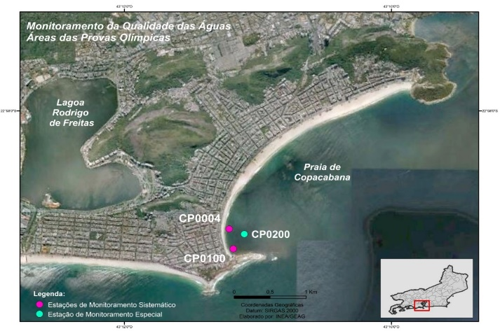
Water Quality Assessment (Sea)
Enterococci
Insert Sample Date | NMP/100mL
Location A | 10
Location B | 10
Location C | 10
Enterococci limit | <100
E.Coli
Insert Sample Date | NMP/100mL
Location A | 80
Location B | 80
Location C | 80
Enterococci limit | <250
PH
Insert Sample Date
Location A | 7
Location B | 7
Location C | 7
PH limit | 6-9
Insert map of course layout with sample’s locations
Weather forecast
Day | Weather
Briefing (B) | Overcast with light rain
B +1 | Overcast (20% chance of rain
Race Day | Overcast (20% chance of rain
Weather report
Day | Weather
B-3 | Heavy rain in the evening
B-2 | Sunny
B-1 | Sunny
SUMMARY
Add text from competition rules – 10.3.f.i or 10.3.g.i YOU CAN FOUND IT IT THE SLIDE NOTES BELOW, eg. 3 = ‘Fair Water Quality’: (E.Coli: 250 to 500 or Enterococci 100 to 200), but with potential or poor visual pollution during sanitary check and/or potential for forecast of heavy rain;
Visual Sanitary Inspection (last 12 hours)
Location | Visual Pollution | Odour | Time of visit | Comments
Location | None | None | 09:15 | Insert comments if necessary
<Insert Event Logo>
Update orange text accordingly
Notes:
Water Quality Decision Matrix (Sea and Transition water)
1 = ‘Very Good Water Quality’: (E.Coli < 250 or Enterococci < 100) with no or potential visual pollution during sanitary check or forecasted heavy rain;
2 = ‘Good Water Quality’: (E.Coli < 250 or Enterococci < 100) with poor visual pollution during sanitary inspection or forecasted heavy rain;
2 = ‘Good Water Quality’: (E.Coli: 250 to 500 or Enterococci 100 to 200) but with no or potential visual pollution during sanitary inspection or forecasted heavy rain;
3 = ‘Fair Water Quality’: (E.Coli: 250 to 500 or Enterococci 100 to 200), but with potential or poor visual pollution during sanitary check and/or potential for forecast of heavy rain;
4 = ‘Poor Water Quality’: (E.Coli > 500 or Enterococci > 200), with any visual pollution during sanitary check and/or potential for forecast of heavy rain.
Water Quality Decision Matrix (Inland water)
1 = ‘Very Good Water Quality’: (E.Coli < 500 or Enterococci < 200) with no or potential visual pollution during sanitary check or forecasted heavy rain;
2 = ‘Good Water Quality’: (E.Coli < 500 or Enterococci < 200) with poor visual pollution during sanitary inspection or forecasted heavy rain;
2 = ‘Good Water Quality’: (E.Coli: 500 to 1000 or Enterococci 200 to 400) but with no or potential visual pollution during sanitary inspection or forecasted heavy rain;
3 = ‘Fair Water Quality’: (E.Coli: 500 to 1000 or Enterococci 200 to 400), but with potential or poor visual pollution during sanitary check and/or potential for forecast of heavy rain;
4 = ‘Poor Water Quality’: (E.Coli > 1000 or Enterococci > 400), with any visual pollution during sanitary check and/or potential for forecast of heavy rain.

Slide 46
Water Quality Assessment (Inland)
Enterococci
Insert Sample Date | NMP/100mL
Location A | 10
Location A | 10
Location A | 10
Enterococci limit | <200
E.Coli
Insert Sample Date | NMP/100mL
Location A | 80
Location A | 80
Location A | 80
Enterococci limit | <500
PH
Insert Sample Date
Location A | 7
Location A | 7
Location A | 7
PH limit | 6-9
Insert map of course layout with sample’s locations
Weather forecast
Day | Weather
Briefing (B) | Overcast with light rain
B +1 | Overcast (20% chance of rain
Race Day | Overcast (20% chance of rain
Weather report
Day | Weather
B-3 | Heavy rain in the evening
B-2 | Sunny
B-1 | Sunny
SUMMARY
Add text from competition rules – 10.3.f.i or 10.3.g.i YOU CAN FOUND IT IT THE SLIDE NOTES BELOW, eg. 3 = ‘Fair Water Quality’: (E.Coli: 500 to 1000 or Enterococci 200 to 400), but with potential or poor visual pollution during sanitary check and/or potential for forecast of heavy rain;
Visual Sanitary Inspection (last 12 hours)
Location | Visual Pollution | Odour | Time of visit | Comments
Location | None | None | 09:15 | Insert comments if necessary
<Insert Event Logo>
Update orange text accordingly
Notes:
Water Quality Decision Matrix (Sea and Transition water)
1 = ‘Very Good Water Quality’: (E.Coli < 250 or Enterococci < 100) with no or potential visual pollution during sanitary check or forecasted heavy rain;
2 = ‘Good Water Quality’: (E.Coli < 250 or Enterococci < 100) with poor visual pollution during sanitary inspection or forecasted heavy rain;
2 = ‘Good Water Quality’: (E.Coli: 250 to 500 or Enterococci 100 to 200) but with no or potential visual pollution during sanitary inspection or forecasted heavy rain;
3 = ‘Fair Water Quality’: (E.Coli: 250 to 500 or Enterococci 100 to 200), but with potential or poor visual pollution during sanitary check and/or potential for forecast of heavy rain;
4 = ‘Poor Water Quality’: (E.Coli > 500 or Enterococci > 200), with any visual pollution during sanitary check and/or potential for forecast of heavy rain.
Water Quality Decision Matrix (Inland water)
1 = ‘Very Good Water Quality’: (E.Coli < 500 or Enterococci < 200) with no or potential visual pollution during sanitary check or forecasted heavy rain;
2 = ‘Good Water Quality’: (E.Coli < 500 or Enterococci < 200) with poor visual pollution during sanitary inspection or forecasted heavy rain;
2 = ‘Good Water Quality’: (E.Coli: 500 to 1000 or Enterococci 200 to 400) but with no or potential visual pollution during sanitary inspection or forecasted heavy rain;
3 = ‘Fair Water Quality’: (E.Coli: 500 to 1000 or Enterococci 200 to 400), but with potential or poor visual pollution during sanitary check and/or potential for forecast of heavy rain;
4 = ‘Poor Water Quality’: (E.Coli > 1000 or Enterococci > 400), with any visual pollution during sanitary check and/or potential for forecast of heavy rain.

Slide 47
Weather forecast
Temp Weather
Friday ….ºC <type>
Saturday ….ºC <type>
Sunday ….ºC <type>
<Insert Event Logo>

Slide 48
Good Luck!
<Insert Event Logo>

