Slide 2
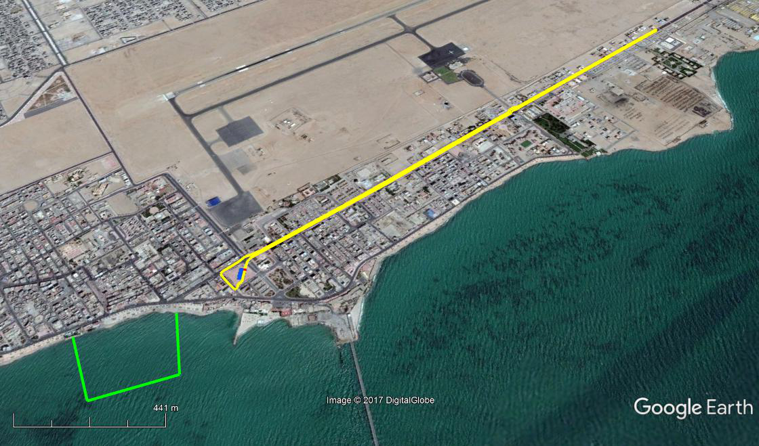
GENERAL

Slide 3
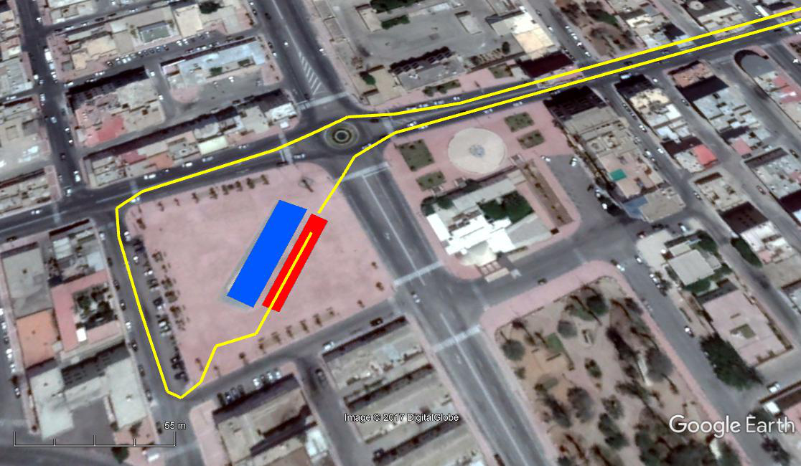
VENUE
Official Hotel
Biefing
Main Venue

Slide 4
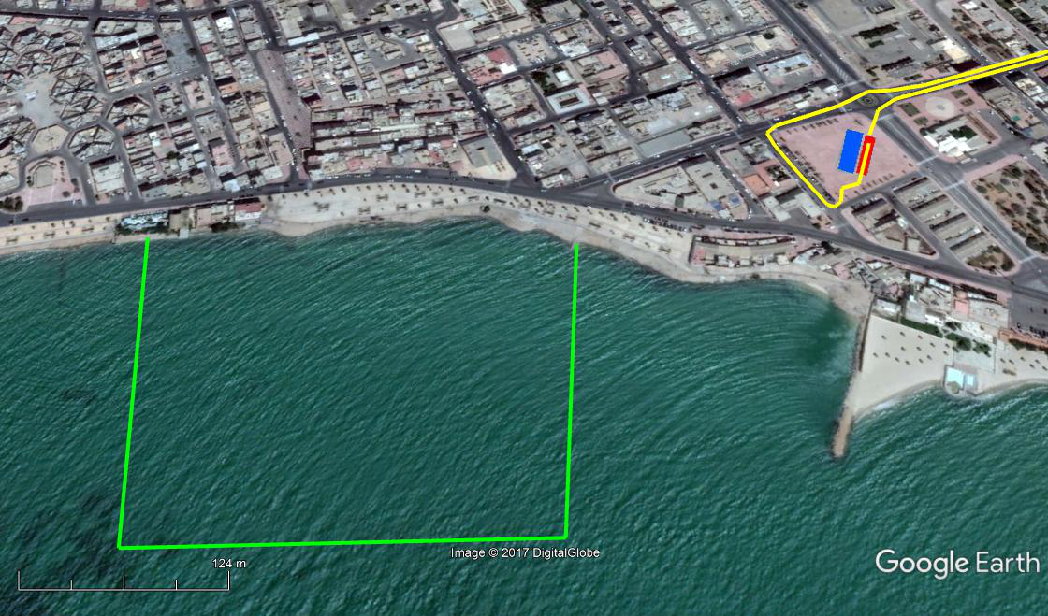
SWIM
1 Lap x 750 m

Slide 5
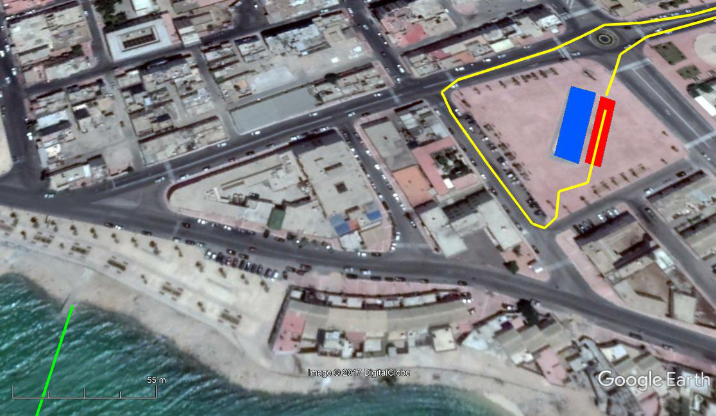
TRANSITION 1

Slide 6
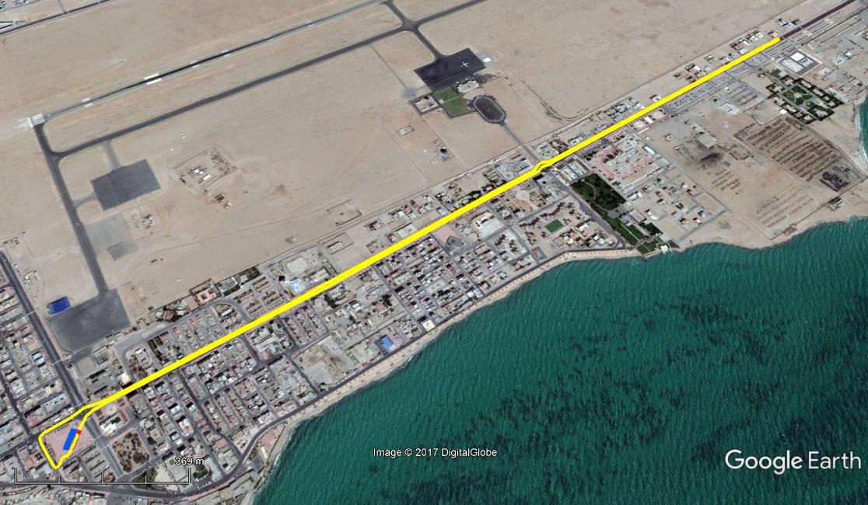
BIKE
4 Laps x 5 Km

Slide 7
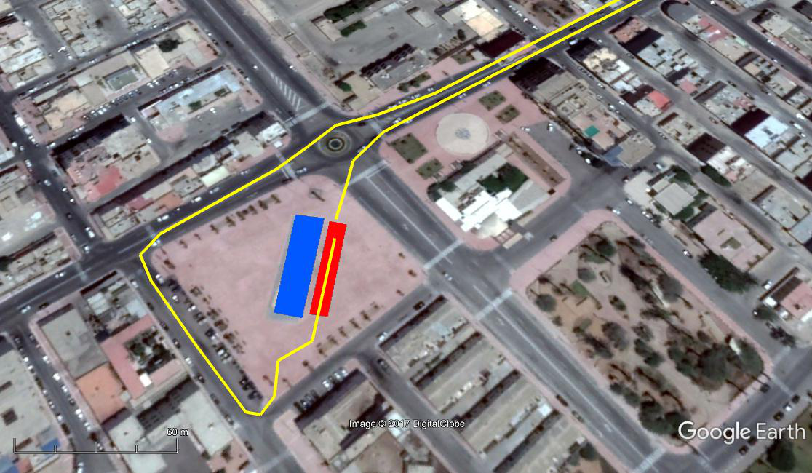
TRANSITION 2

Slide 8
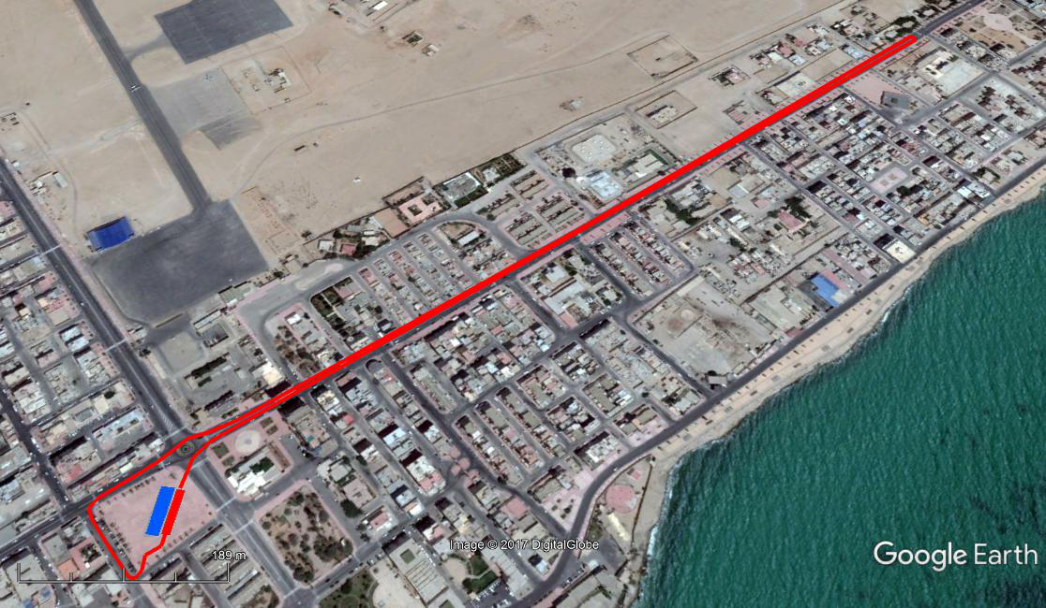
RUN
2 Laps x 2,5 Km

Slide 9
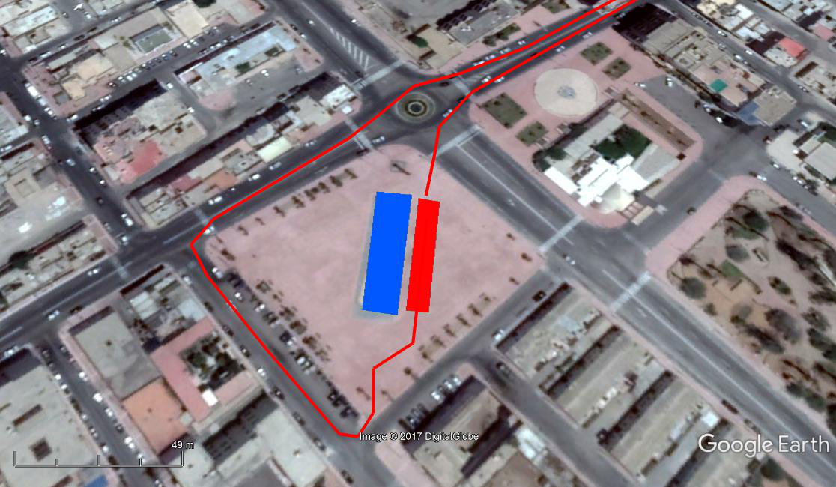
FINISH

