Slide 1
Elite Athletes Briefing
Thursday, 11 October 2018

Slide 2
Briefing Agenda
Welcome and Introductions
Competition Jury
Competition Format
Schedules and Timetables
Check-in and Procedures
Course Details
Post-Race Procedures
Weather Forecast

Slide 3
Welcome and Introductions
Leslie Buchanan, ITU Team Leader
Dr. Wes Ruffin, ITU Medical Delegate (USA)
Janice Turner, ITU Technical Delegate (CAN)
Dan Frost, ITU Assistant Technical Delegate (USA)
Andrew Dacanay, ITU Race Referee (CAN)
Dr. Joanne Fava, LOC Medical
Craig Hanken, LOC Technical Operations
Brian D’Amico, LOC Race Director

Slide 4
Competition Jury
Elite Women
Dan Frost, Chair
Barry Siff, ITU Executive Board
Tim Yount, USA Triathlon
Elite Men
Janice Turner, Chair
Barry Siff, ITU Executive Board
Tim Yount, USA Triathlon

Slide 5
Competition Format
Pending final water quality results expected mid-day Friday, Oct. 12, 2018
If results comply with ITU Competition Rules 10.2.b.)(i), competition will be a sprint triathlon as planned
If results do not comply, competition will be a sprint duathlon
75% of original points will be awarded
No change in prize money amount or distribution

Slide 6
Schedule and Timelines
Thursday 11 October 2018
18:30 – 19:00 Race pack pick-up
19:00 – 20:30 Athlete pasta dinner
Friday 12 October 2018
10:00 – 10:45 Bike familiarization
14:00 – 14:45 Swim familiarization (pending)
15:00 Coaches’ run course measurement

Slide 7
Schedule and Timelines
Saturday (Women) 13 October 2018
12:00 – 13:15 Athletes’ Lounge open
12:30 – 13:15 Transition Area open
12:45 – 13:15 Swim warm up open*
13:20 Line up for introduction
13:30 Elite Women start
After Men’s race Medal ceremony

Slide 8
Schedule and Timelines
Saturday (Men) 13 October 2018
14:00 – 15:15 Athletes’ Lounge open
14:30 – 15:15 Transition Area open
14:45 – 15:15 Swim warm up open*
15:20 Line up for introduction
15:30 Elite Men start
~17:00 Medal ceremony

Slide 9
Check-in Procedures
Athletes Lounge:
Uniform check
Name, country code, logos, ITU logo, zippers
Photos taken
Wearing other uniform during the race = DSQ
Body marking check (both arms, both legs)
Swim cap distribution*
Timing chip distribution (1 for the ankle)

Slide 10
Check-in Procedures
After Athlete Lounge:
Bike check
Bike sticker, handlebars, frame, & wheels
See 5.2 of Competition Rules
Approved exemptions on ITU website
Helmet check
Helmets left fastened on the bike in transition = 10 second time penalty
Spare wheels checked

Slide 11
Pre-Start Procedure
Athlete Introduction:
10 minutes before start - line-up in Transition Area
ITU swim cap must be worn*
If a second cap is worn, it must be completely unbranded*
Jog to the platform or start line when your name is announced
Select your position and stay there
Blocking more than one position = DSQ
Remain behind the pre-start line

Slide 12
Start Procedure
Athletes in position:
The start can be given any time after “On your mark”
Air horn blast
The race starts
Athletes not moving forward at the start will receive a time penalty of 10 seconds in T1
Delayed starters begin 10 seconds after the main wave

Slide 13
False Start Procedures
False Start (several athletes)
Several horn blasts
Everyone goes back to her/his spot
Early Start (one or a few athletes)
If someone starts before the horn and everyone else starts with the horn, the early starter(s) will receive a time penalty of 10 seconds in T1
During the time penalty athlete cannot make any race progress

Slide 14
Triathlon Course
Swim
1 lap = 750m
Bike
3 laps = 18.3 km
Run
2 laps = 5km

Slide 15
Swim Course
1 lap = 750m (counter-clockwise)
Water temperature: 27.8°C
Distance to the first turn buoy = ~280m
Keep all buoys on your left shoulder except the final one
Take cap, goggles to transition into your box

Slide 16
Swim Course (1 lap)
TRANSITION

Slide 17
Triathlon Bike Course
3 laps of 6.1km
Flat, some technical turns
2 wheel stations
1 neutral wheel station at far end of bike course
1 team wheel station on main road
Lapped athletes are out of the race
First runner – last biker scenario

Slide 18
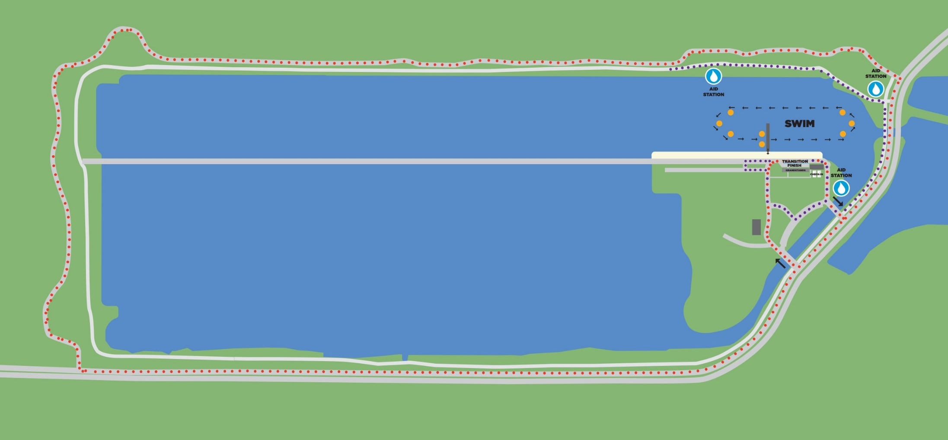
Triathlon Bike Course (3 laps)

Slide 19
Triathlon Bike Course (Island Detail)
Bike Out
First runner/ last biker
Bike In

Slide 20
Triathlon Run Course
2 laps = 5km
Aid stations:
3 per lap
Sealed water
Discard plastic bottles off course in littering zones
Photo finish
Avoid congestion in finish area

Slide 21
Triathlon Run Course (2 laps)
LAPS
Run Out
PB
Finish
Run In

Slide 22
Duathlon Course
Run 1
1 lap = 2.5km
Bike
3 laps = 18.3 km
Run 2
2 laps = 5km

Slide 23
Duathlon Run #1 Course (1 lap)
PB
Start

Slide 24
Duathlon Bike Course (3 laps)
First runner/ last biker

Slide 25
Duathlon Run #2 Course (2 laps)
Run Out
PB
Laps
Finish

Slide 26
T1
Traditional Bike Racks – two rows
Rack by saddle, front wheel facing out
Helmet on the bike
Running shoes in front of the box, helmet on the bike
All used equipment into the box
Mount line at the end of TA

Slide 27
T2
Dismount line at leading end of transition
T2 – rack by both brake levers, both handlebars, or saddle (must not interfere with another athlete)
All used equipment into the box

Slide 28
Penalty Box
The penalty box is for infringements in swim, T1, bike, and T2
Location: approx. 100m before finish line
White board to show race numbers and codes
10 second time penalties served on any lap of the run
Athletes have the option to decide whether to stop at the penalty box and serve the penalty or continue to the finish.
Not serving an assessed penalty will result in a DSQ
The athlete may then appeal the penalty. Evidence will only be made available if an appeal is filed.

Slide 29
Penalty Box
Violations Abbreviations:
Littering: L Mount Line: M
Swim violations: S Dismount Line: D
Other violations: V Equipment outside box: E
For example:
12D = athlete #12 received a time penalty for a dismount line violation
2x12ME = athlete #12 received 2-time penalties for mount line and equipment outside the box violations

Slide 30
Rule Interpretations
Mount after the mount line (M):
Athletes must mount their bicycles after the mount line by having one complete foot contact with the ground after the mount line.
Dismount before the dismount line (D):
Athletes must dismount their bicycles before the dismount line by having one complete foot contact with the ground before the dismount line.

Slide 31
Rule Interpretations
Discharge or store your equipment inside your designated area E):
Athletes must place within 0.5 m of the bin all equipment to be used at a later stage in the event. All equipment already used must be deposited in the bin. An equipment piece is considered deposited in the bin when one part of the equipment is inside the bin.
Rack the bike inside your own space (V):
Bike must be racked by both sides of the handlebar, both brake levers or the saddle within 0.5 m of the rack number or name plate. Bike must be racked in a way that does not block or interfere with the progress of another athlete.

Slide 32
Post-Race Procedures
“Mixed Zone” - immediately after finish
Medal presentations following Men’s race
Assemble in Athlete Lounge
Dress “up”
Ambush marketing rules apply

Slide 33
Post-Race Procedures
Anti-Doping Control
Every athlete must have photo ID ready for Doping Control
Medical
Team medical officials are allowed in this area only with permission from the Medical Delegate

Slide 34
Weather Forecast

Slide 35
Thanks for your patience and Good Luck!

