Slide 1
Athletes briefing
2014 Monterrey PATCO Triathlon American YOG Qualifier
THURSDAY 1 MAY 2014

Slide 2

Briefing agenda
Welcome and Introductions
Competition Jury
Schedules and Timetables
Check-in and Procedures
The course
Post-Race Procedures
Weather forecast

Slide 3

Welcome and Introductions
Andrew Armstrong, ITU Technical Delegate
Felix Molina, ITU Assitant Technical Delegate
Cinthia Quilo, ITU Race Referee
Mauricio Alvarez, LOC Director

Slide 4
Competition Jury
Andrew Armstrong, Chair
Antonio Alarco, PATCO President.
Dr. Ignacio Lopez, Medical Delegate

Slide 5
Schedule and Timelines
Thursday
18:00 – 17:00 Race pack pick-up (after the athletes’ briefing)

Slide 6
Schedule and Timelines
Friday
09:00 – 0930 Swim familiarisation on course
15:30 – 16:20 Athletes’ Lounge open and check-in for Youth Women
16:00 – 16:35 Transition Area open for Youth Women
16:10 – 16:45 Warm-up for Youth Women
16:50 Line up & Introductions (walk to start)
17:00 Youth Women Start
20:15 Medal ceremony (Arrive at 20:00)

Slide 7
Schedule and Timelines
Friday
17:55 – 18:30 Athletes’ Lounge open and check-in
18:00 – 18:30 Transition Area open for Youth Men
18:25 – 18:45 Warm-up for Youth Men
18:50 Line up & Introductions (walk to start)
19:00 Youth Men Start
20:15 Medal ceremony

Slide 8
Check-in procedures
Athletes Lounge
  Uniform check (name, country, logos, ITU logo, zippers) – photos taken of each uniform. Wearing other uniform during the race = DQF!
  Body marking check (both arms, both legs)
  Timing chip distribution
  Swim cap distribution

Slide 9
Check-in procedures
Transition Area
  Bike check: handlebars & wheels (non authorized UCI wheels rule)
  Helmet check - Don’t leave your helmet fastened in the transition
  The athlete who misses to comply with this rule will receive a time penalty of 10 seconds in TA1.
  Running Shoes outside the box, helmet on the bike
  Spare wheels to the wheel-stop
  To add any equipment to the bike, you must obtain approval from the Race Referee up until 10 minutes after the end of the Athletes‘ Briefing.

Slide 10
Pre-start Procedure
Athlete Introduction:
10 minutes before start - line-up under the swim start gantry
Jog to the platform
Select your position and stay behind the line!
Athlete blocking more than one place will result DQF

Slide 11
Start Procedure
Athletes in position:
The start can be given any time after the TD announces “On your mark”
Air horn blast
The race starts
Athletes not moving forward at the start will receive a time penalty of 10 seconds in TA1.

Slide 12
False Start Procedures
False start Example 1:
Several horn blasts
Kayaks in front of you
Everyone goes back to her/his spot
False start Example 2:
If someone starts before the horn and everyone else starts with the horn, the athlete who false started will receive a time penalty of 10 seconds in TA1.
During the time penalty athlete can not take any equipment!

Slide 13
The Course
Swim
Point to point. 750 mts
Bike
4 laps of 4.80km
Run
2 laps of 2.5 km

Slide 14
Swim course
Water temperature: 21.7°C
Wetsuit not allowed
750 mts point to point swim
Take cap, goggles to transition into your box

Slide 15
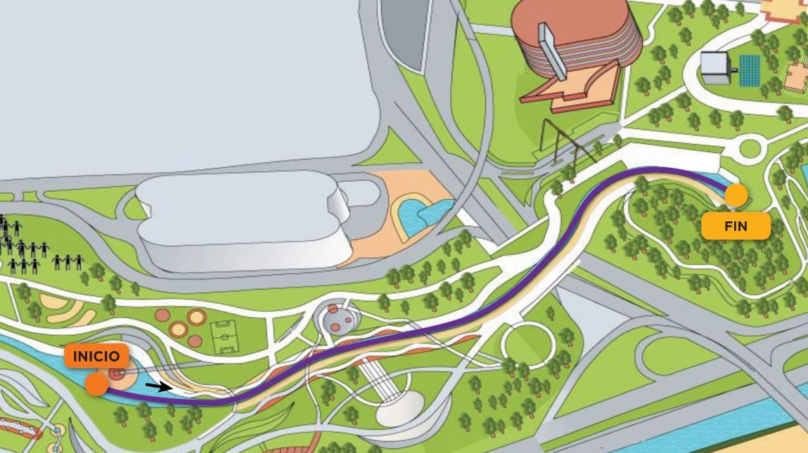
Swim course Map

Slide 16
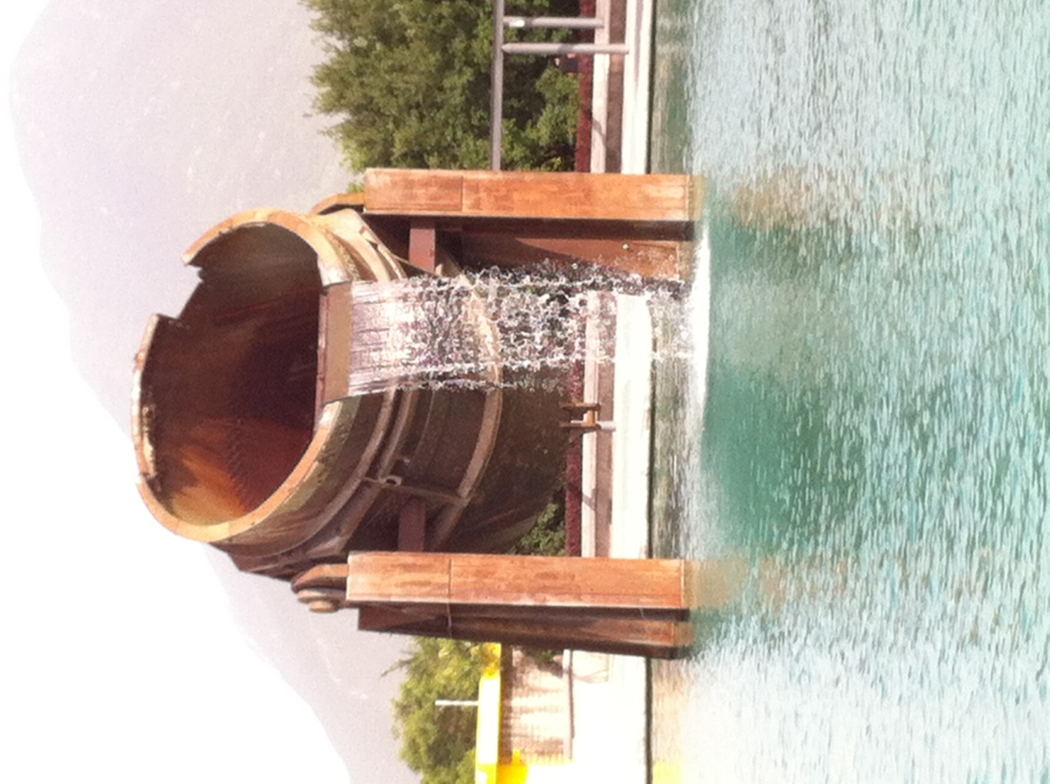
Swim Exit

Slide 17
Transition Area
  Individual Bike Racks – number, name and country flag
  Running shoes in front of the box, helmet on the bike
  Googles & swim caps into the box
  Bags to the Athletes Lounge
  Practice the flow of Transition
    T1 – Rear wheel in rack, facing inside of Transition, exit using inside lane of Transition
    T2 – Front wheel in rack, exit down the middle of Transition
  Mount line at the end of the TA

Slide 18
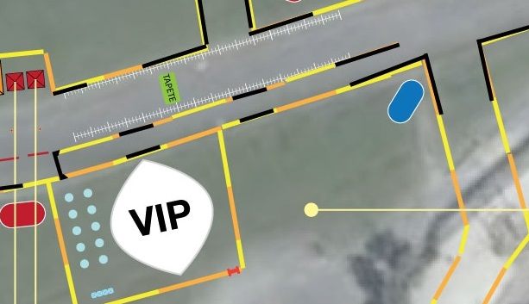
Transition Flow
LOUNGE
TZ

Slide 19
Bike course
4 laps total distance of 19 kms
Flat and technical
Bumps – painted yellow
1 Wheel Station
  1 Team wheel station
  See the map
Lap Counter in front of TA
Lapped athletes are out of the race
  First runner – last biker case

Slide 20
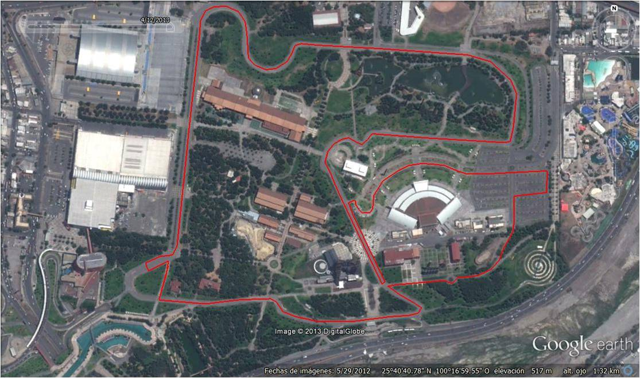
Bike Course Map
Wheel Stop
Mount / Dismount

Slide 21
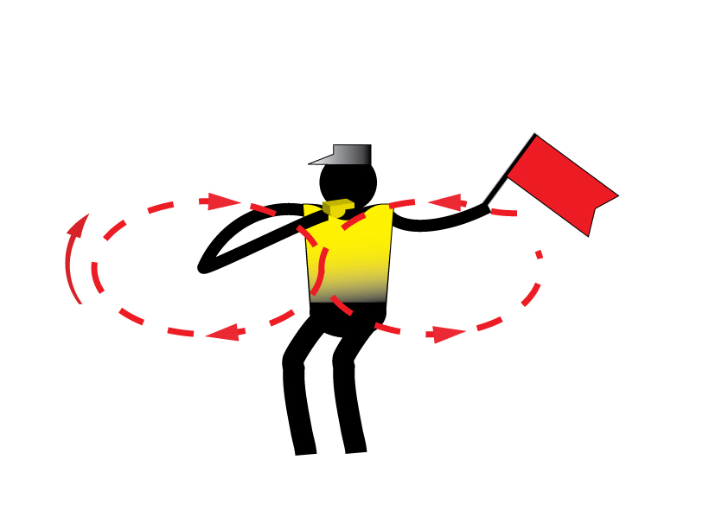
Caution
Caution signal: three sharp whistles and red flags

Slide 22
Transition Flow
lap
Dismount
TZ

Slide 23
Run course
2 laps total distance of 5 km
Aid stations:
  3 per lap
  For locations see the map
  Sealed water and ice
  Discard plastic bottles off course
Congestion in finish area:
  Go to mixed zone / recovery area

Slide 24
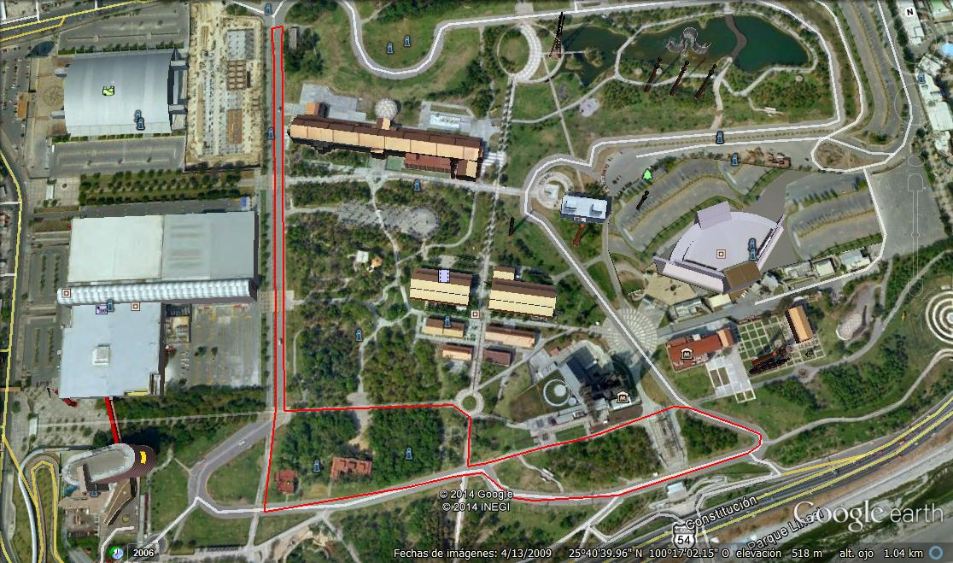
Run Course Map
Water Station
Finish
PB

Slide 25
Run Penalty Box
The penalty box is for infringements in: TA1, bike and TA2
e..x.: Mount before mount line, dismount after dismount line, discharge or store your equipment outside your designated area, rack the bike outside your own space etc
(Transition will be recorded for infringements)
Location: 50m before the Transition Area
Information: White board to show race numbers
(Athletes need to read the board – coaches are advised to check and inform their athletes)
Procedure: 10 second time penalty served on any lap of the run
If you don’t stop - DSQ

Slide 26
Run Penalty Box
Rule interpretation
Mount after the mount line: It has to be one contact of the athlete foot with the floor after the mount line. If this contact doesn’t occur the action is considered as mount the bike before the mount line.
Dismount before the dismount line: It has to be one contact of the athlete foot with the floor before the dismount line. If this contact doesn’t occur the action is considered as dismount the bike before the dismount line.
Discharge or store your equipment inside your designated area: Leaving the equipment (swim cap, googles, helmet, etc.) in the designated box.
Rack the bike inside your own space: In case of Individual bike rack, the bike must be racked with the front wheel to the designated rack.

Slide 27
Post-race Procedures
“Mixed Zone” - immediately after finish 1, 2, 3 with host broadcaster first.
Medal Presentation - protocol – at 20:15 – be on time!
Dress “up”

Slide 28
Coaches areas
Accreditation
Every coaches has to collect accreditation to be able to enter the venue.
Only Coaches who have been registered from their NF into the ITU online system are entitle for an accreditation.

Slide 29
Important Updates
If you Qualify for YOG * NOTE: Uniform Rules for YOG are DIFFERENT – see ITU web site!
Relay Briefing – Only Coaches are required – bring the names of your team!

Slide 30
Weather forecast
Temp Weather
Friday 19 ºC Cloud / rain?
Saturday 26 ºC Sun
Sunday 17 ºC Sun

Slide 31
Good Luck!

